Slide 1
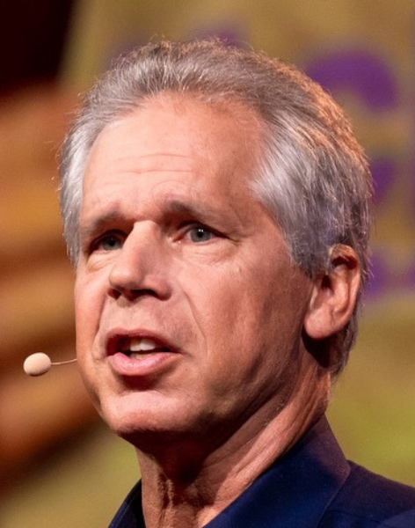


THE SOCIAL LICENCE CHALLENGE: LESSONS LEARNED FROM THE BATTLEFRONT
BOB
LANGERT
Former Vice President of Corporate Social Responsibility and Sustainability, McDonald’s

Slide 2
The Social Licence Challenge:
Lessons Learned From
The Battlefront
Bob Langert
Retired VP, Sustainability and Corporate Social Responsibility
McDonald’s Corporation
Author: “The Battle To Do Good”
Notes:
Great to be here
Share McD Turbulent Journey
“Battlefield” …..Feel like you’re being attacked, unjustly,
Believe me, I know how that feels
But it’s a battle you can win,
100% conviction: You can do good for society and your business
Shift from reactive and defensive
To Core to your business and strategic.

Slide 3
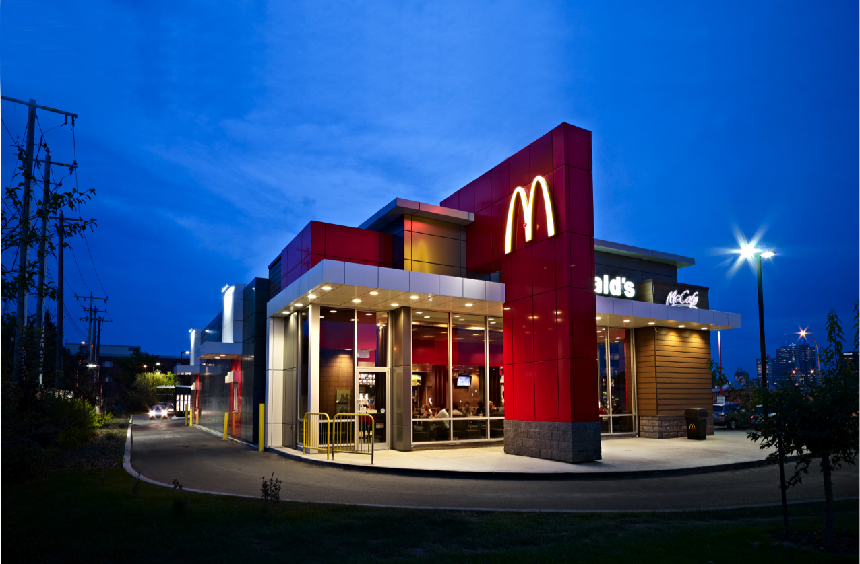
1.8 million employees
70 million customers/day
45,000+ restaurants
120 countries
212_12903_Edmonton_01_Exterior_V3.jpg
Notes:
Very consumer centric, we serve all
1% of the world population
World’s largest small business, 5000 owner operators
Sustainability was not top top.
Sustainability had to be practical for these entrepreneurs who pinch every penny

Slide 4
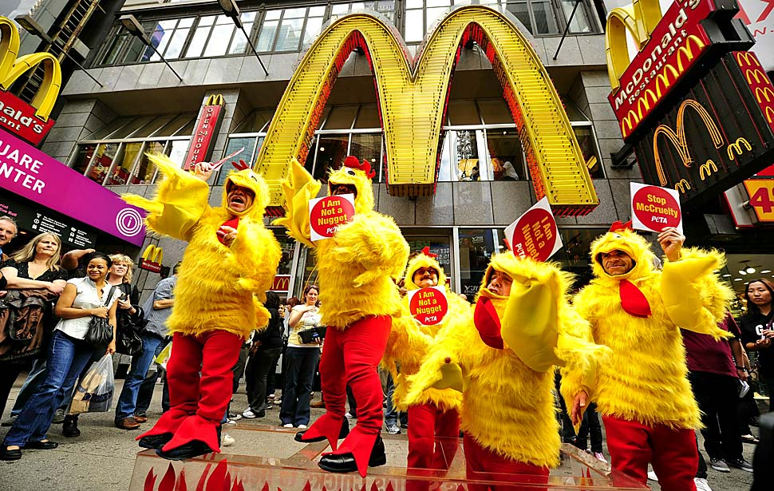
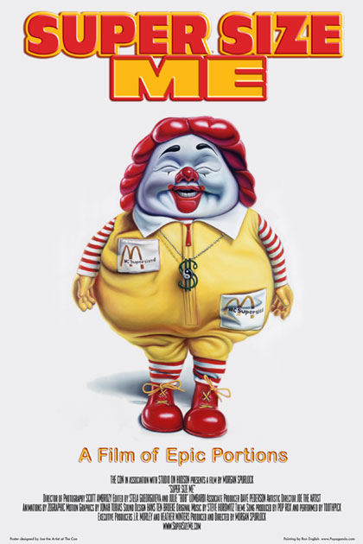
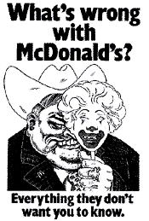
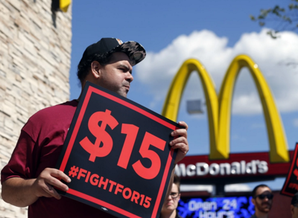
Notes:
McDonald’s …seemed liked we were attacked every day, relentlessly.
We sure were an easy target for NGOs precisely because its brand is so valuable and our omnipresent street corner presence.
Books
Campaigns
Movies
Garbage, obesity, rainforest destruction, animal cruelty
Tell McSpotlight story, Leaflet. How many here know of this. 1991. Many describe as one of the top ten worst PR decisions of all time. Ended up[ being the longest civil lawsuit in British history.
Wondered how we made it through. Wall Street declared us dead a few times.
One key way we made: WE TOOK Corporate Responsibility VERY SERIOUSLY.

Slide 5
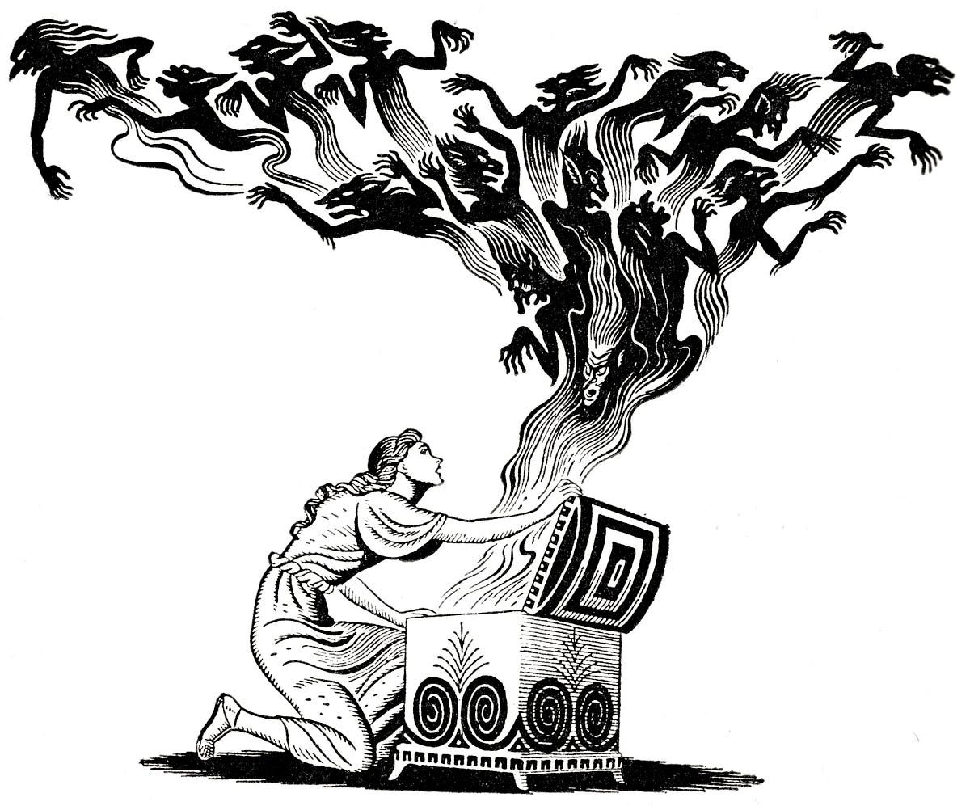
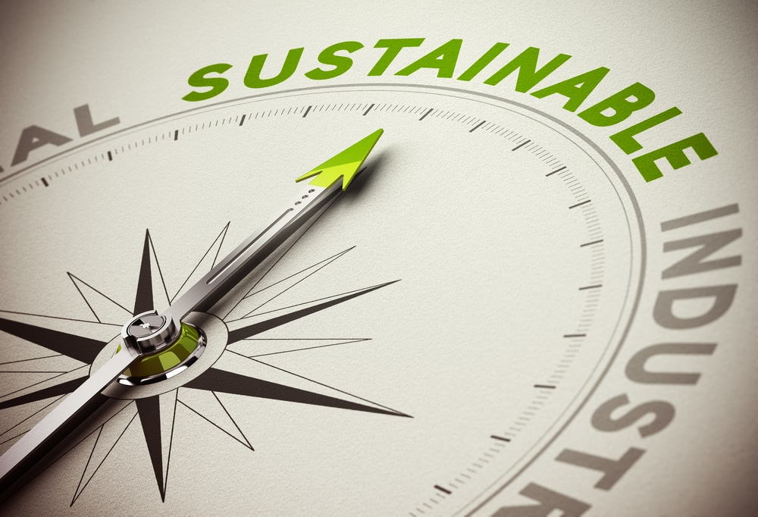
Pandora’s Box > Opportunity
Notes:
Share McD Conversion
Full of crises, defense, and denial
To a key to business growth and success
Share what worked, what did not work.
Biggest mistakes and wishes for do-overs

Slide 6
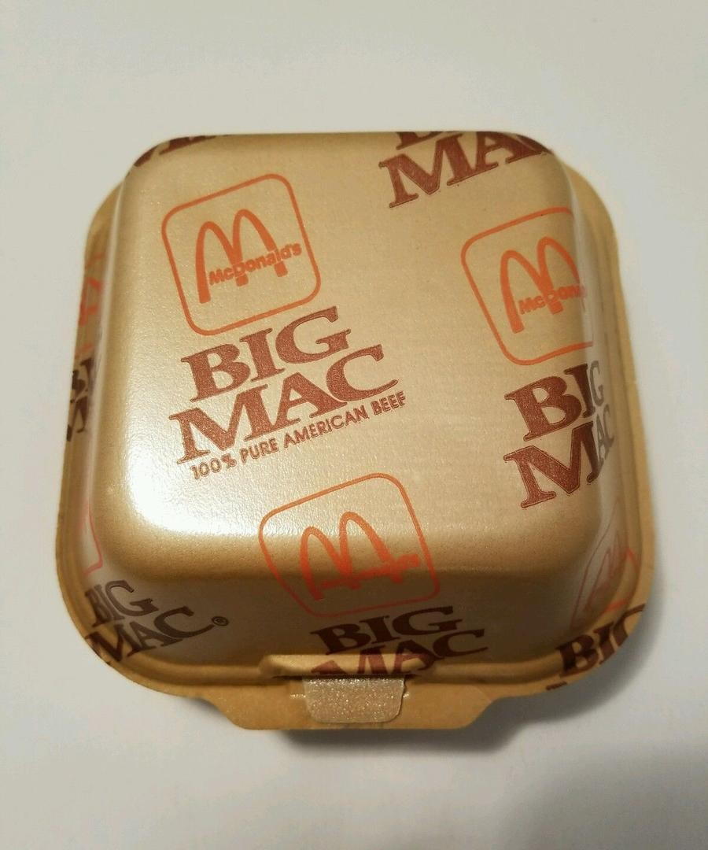
Notes:
First Battle: Waste
1989, remember this notorious clamshell?
We became symbol of a garbage crisis.
School kids..I visited schools with junior high kids hanging from the rafters yelling at me in rage.
”This is not fair…..

Slide 7

Notes:
Our Ronald McDonald joyful mascot was demonized.
1995: Golden Arches shined…now tarnished and bashed.
My neighbors and friends were quizzing me. I felt guilty
So one of our top exec had a break through idea: To partner with our critics..
Big splash, unheard of
EDF partnership: Fortune magazine; declared: inviting the fox into the hen house
No one knew anything about green packaging.
Plucked me to lead this partnership

Slide 8
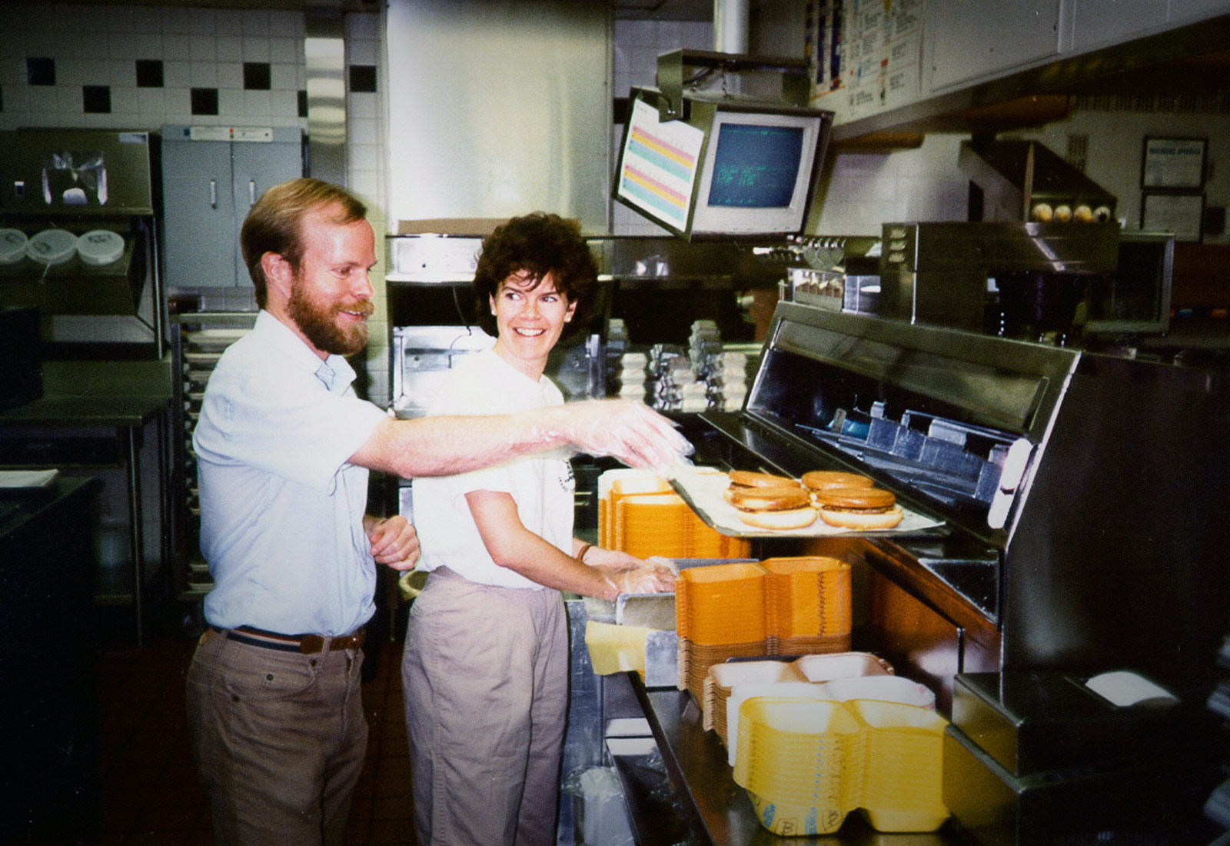
Notes:
Here is not McD crew members….but EDF scientists.
Part of the ”deal” was we asked them to work in our restaurants
Don’t change us to a fancy sit down restaurant.
We would remain fast food…
They insisted on open access, so we agreed to let them see, hear, review anything.
Me nervoius? Yes, Treehuggers….Sue the Bastards
Grew to admire, friends
Reduced packaging 42 reductions 300 millionis pounds

Slide 9
“This partnership showed that collaboration can effectively spur innovation and lead to powerful results that make sense for both business and the environment.”
Fred Krupp, President of the Environmental Defense Fund
Notes:
Hit the jackpot; We desperately needed a third party endorsement
Worth millions!

Slide 10
Openness
+
Collaboration
+
Action
Successful Societal Engagement
Trust
No extra cost
=
Notes:
Openness: McD’s truly opened our doors, nothing to hide.
Collaboration: Couldn’t do alone
Action: outhouse to the White House
This is the template that I would implement dozens of times related to numerous issues. This is the framework for all o our future work.

Slide 11
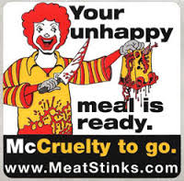
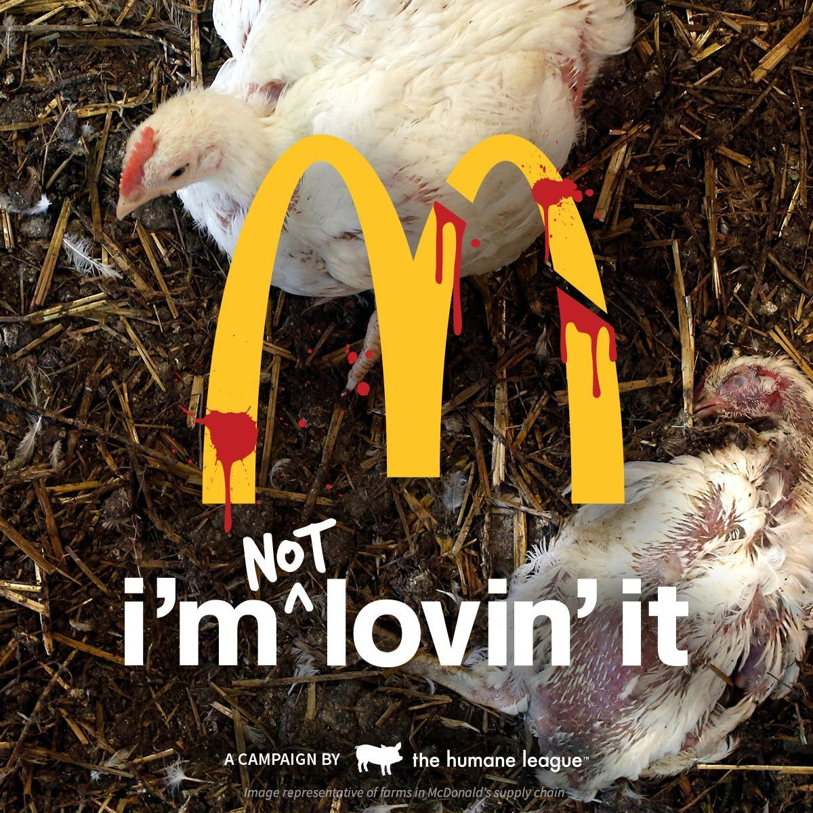
Notes:
Next battle: Animal Rights
Closer to home….
Sum up the problem.
Meat 2%
Peta, pressure, what could we do? At this time, the late 90’s, at a loss, since animal production was way upstream, way beyond our control and influence
I was asked to come up with a strategy to get out of the target zone

Slide 12
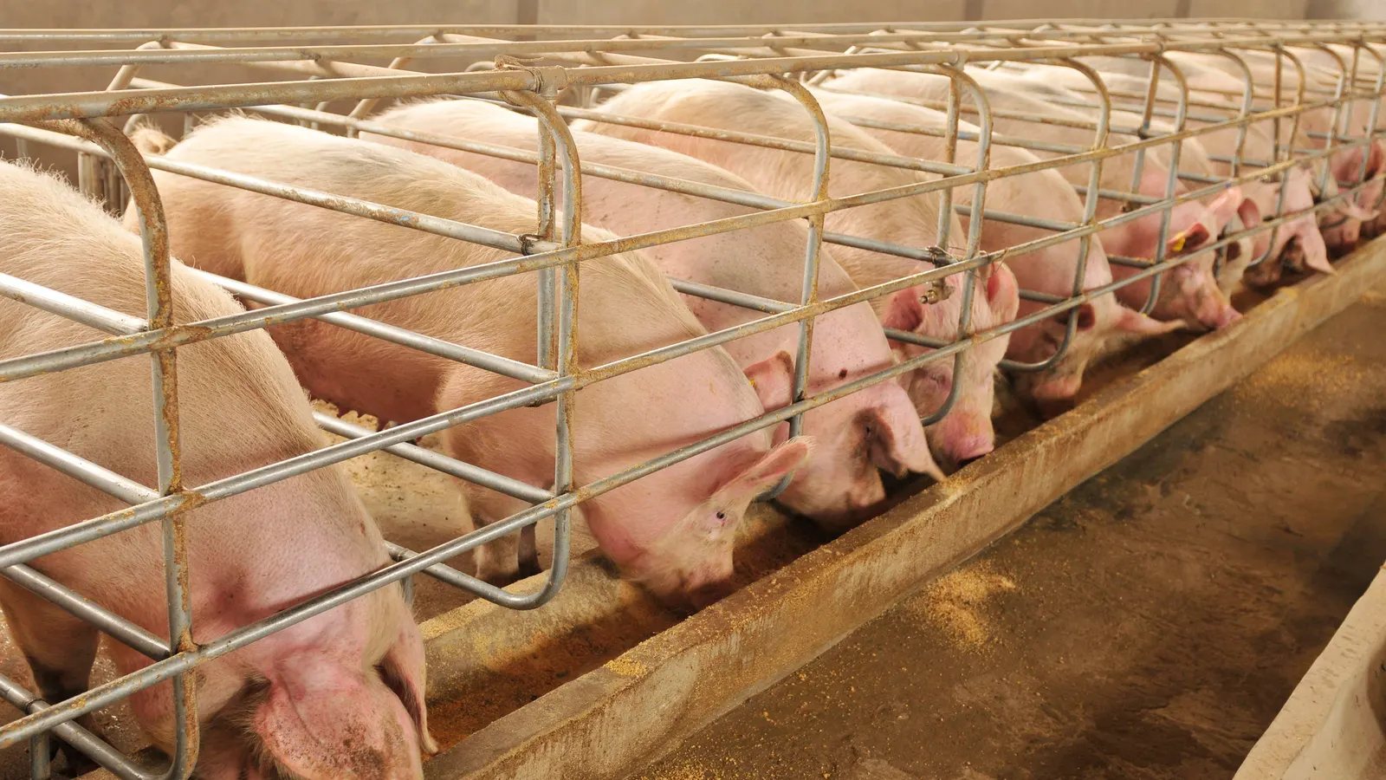
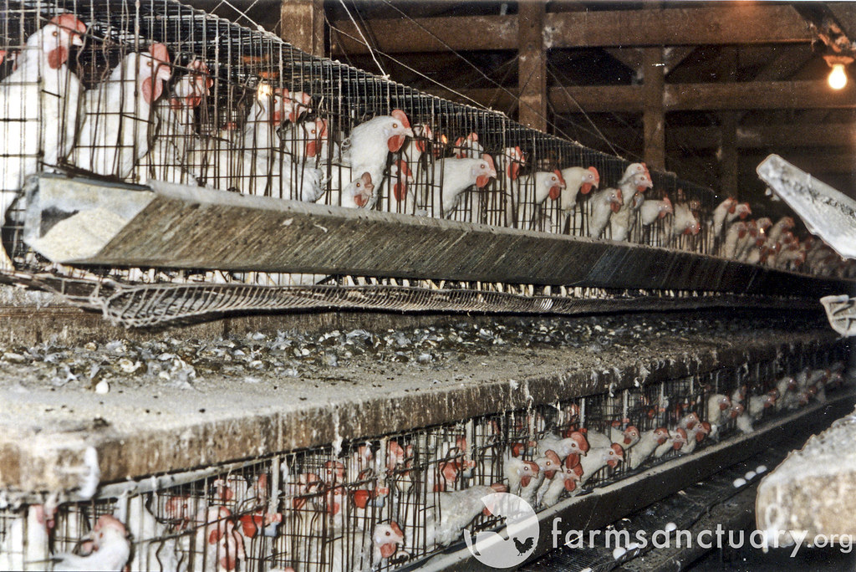
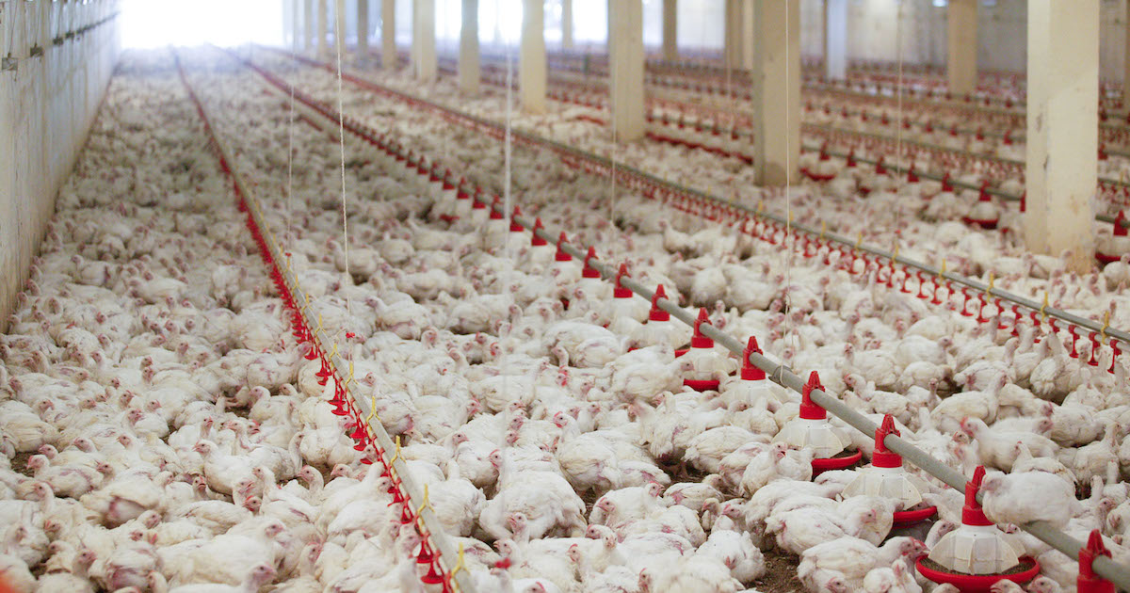
Notes:
So I visited suppliers who raised pigs, hens, and chickens…
What I learned, was I was very uncomfortable with what I saw….
In talking to suppliers, about gestations stalls or crammed battery cages, this was all good, efficient. They are healthy.
Daunting about our food is that the animals are living creatures, not a napkin or cup.
Ethics needed to added in. What is right and wrong?
Needed a way to combat the emotion that PETA was generating with consumers…
Created AWC

Slide 13
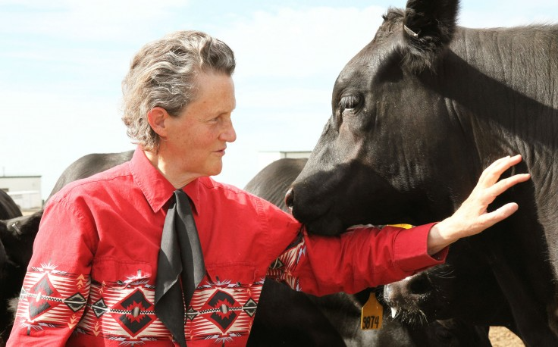
Notes:
Led by a renowned animal behavioral scientist.
Most impactful person I’ve ever known.
Autistic.
Blue sky concept: Measure animal welfare
Audits

Slide 14


Slide 15
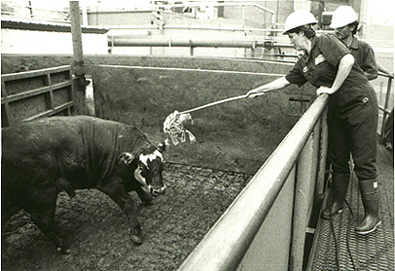
Notes:
So we decided to give Temple the keys to our supply chain
We would and measure our meat suppliers
I went with her on many of these audits.
Electic prods
Hog dying in the aisle
I always articulated internally at McD if we don’t want to see certain practices on the front page of the NY Times, need to change, or be able to support why we do what we do
2=3 years: Did audits, delisted suppliers, took action, came up with improvement plans
Ended up making animal welfare SOP, on the map!
Globally
And with our competitors

Slide 16
“I saw more animal welfare progress throughout the industry by working with McDonald’s than I had done in all my previous 25 years of work.”
Dr. Temple Grandin
Notes:
We put PETA where they belong, on the fringes.
Again, we had a incredible 3rd party saying we were doing a good job.

Slide 17
Openness
+
Collaboration
+
Action
Successful Societal Engagement
Trust
No extra cost
=
Notes:
Same formula of success.
Really transitioned from an issue of animal rights to one of animal welfare.
Again, no extra cost, mostly a mindset, training, and practical investments.

Slide 18
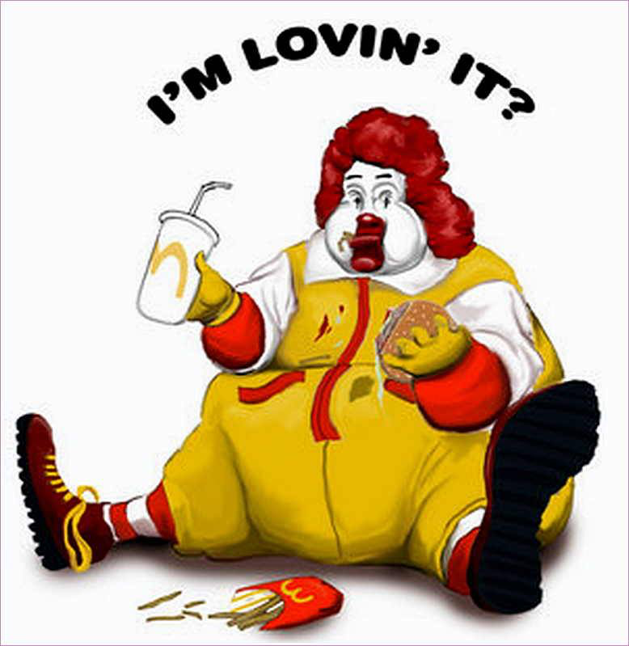
Notes:
Next battle;;Junk food, obesity
Bulls eye’
Real challenge, our toughest, to influence and change how our custumer’s eat. Very limited.
Formed a Healthy Lifestyle Council.
Open access, for example meetings with our CEO
Challenged us on Super Size drinks, and convinced us to get rid of this.

Slide 19
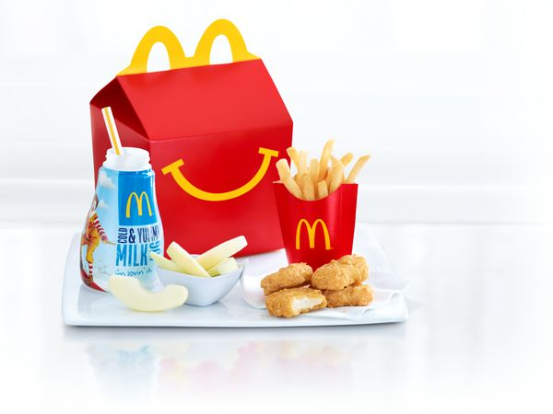
Notes:
We tried and tried for 8 years….
Finally, our council said kids and Happy Meals. Describe the changes we made
Sweet spot. Our responsibility

Slide 20
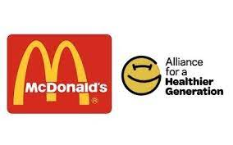
"When Healthier Generation collaborated with McDonald's to set these goals in 2018, we could not have imagined the ways in which our world and businesses would have to adapt. Nevertheless, McDonald's dedication and persistence toward the goals, and ultimately to families around the world, resulted in meaningful change.”
Kathy Higgins, chief executive officer at Alliance for a Healthier Generation
Notes:
Couldn’t dream of a better endorsement. Millions
Key: Gave us permission, social licence, to continue serving our food to our adult customer base, because we are addressing the obvious, our role with children.

Slide 21
Openness
+
Collaboration
+
Action
Successful Societal Engagement
Trust
No extra cost
=
Notes:
Best of all: Good for our business.
Happy Meal sales rebounded.
Mothers were not as saying not anymore as much to bring their families to McD

Slide 22

1990-2014
Societal Report Card
Crisis Management: A
Strategic integration: F
Brand health: F
Communication: F
Notes:
So let’s fast forward to 2014, 25 years
Sure, success in packaging, animal welfare, and better Happy Meals.
We had other issues, working with Greenpeace on eliminating soy production in Brazil that caused Amazon rain forest destruction..
So yes, an A in crisis management
But all disconnected.
No strategy, Not getting credit. Totally reactive.

Slide 23
Anticipatory Societal Management
Publicity/
Exposure
and Who Is Involved
Public
Politicians
Interest Groups
Media
Scientists Academe
“Fringe”
Opportunity
Phase
Emergence
Triggering Event
“Crisis”/Public Positioning
Resolution
Best Opportunity to Save Resources, Cost & Reduce Risk
Time
Anticipatory
Crisis
23
Notes:
We were living in the wrong side, right side of this graph. I called it a disease of Wait Wait, Waitl for the crisis.
I used this graph relentlessly at our internal meetings.
We saw ahead the issues that were on the horizon.
But why address, will it really be a problem for us?
Emphasis that is Wait Wait Disease is prevalent today, and the biggests problem I see.

Slide 24

71% of McDonald’s customers:
“Don’t feel good about the food they are eating.”
Notes:
Also add in how our communication was typical of all other corporate approaches:
Denial, push back, reactive, ”Who, Me? We’re not the problem.
Or hide out, don’t open pandora’s box…
We need to have things perfect to communicate on sustainability….
Guilty on all charges!

Slide 25

OUR JOURNEY. TOGETHER FOR GOOD.
Right thing to do
Disjointed
Potpourri of local, global, and AOW activities
Hard to drive sustainable effort that breaks through
Central to growing our business & brand
Aligned across the system
Focused vision and global framework
Sharing our story & getting credit
2
Notes:
Finally. Our new CEO in 2014 decided to not let others dictate our brand, our story, our commitment to doing good.
He ask that I create strategy for our company. He asked for “boldness.”
Hallelujah! My day had finally arrived to be proactive!!!
This slide is an important one. It was the main slide to convince our BOD to approve our plan.
Describe …I bet many of you feel this way about your company, your organization…
But this started my last Battle, The Battle to Integrate in our Company,. The Internal battle!

Slide 26
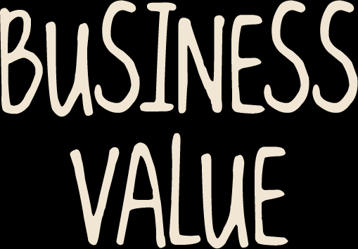
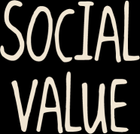

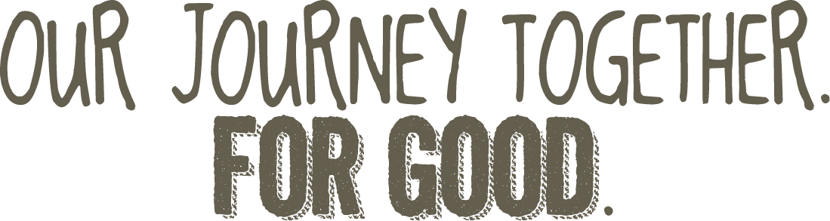
GROWING OUR BUSINESS BY MAKING A POSITIVE DIFFERENCE IN SOCIETY
1
Notes:
Here’s another pivotal slide:
Shared Value. ….describe
Drafted 9 goals, under five pillars of Food, Supply Chain, People, Community, Planet
Remember Bold: Ie all packaging and food to come from sustainable sources
Rejected by senior management. Describe risk averseness…We just opened in Vietnam, “we’re going to have sustainable food there?” ”Can’t we end up in jail if we don’t meet these targets?
Booted out of the room, asked basically to dumb it down.
So went back to my cross functional team and we all decided dumbing the plan down was bad for the company. Our stakeholdes would sniff this out in a hearbeat.

Slide 27
The Leadership Spectrum
100%
GOAL UNCERTAINTY
0%
1
2
3
4
5
SUSTAINABILITY LEADERSHIP
6
Notes:
So I went back a month later, with only minor tweaks to the Bold plan.’
And I used this leadership curve.
Describe risk vs. leadership
Can’t have leadership without some calculated risk.
Put our competitors and peers on the graph..
And I asked them what they wanted. To lead? Which has risk.
Or to play it safe, and remain a laggard, and probably remain tied to the whipping post for our critics
They approved the plan!

Slide 28
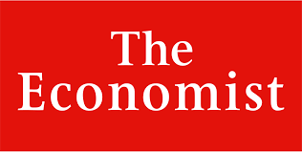

A 25-year battle to improve the image of McDonald’s
Do you want ethics with that?
Notes:
So we now had our framework, goals, measures, and accountability.
I couldn’t believe it. It was such a huge milestone, for me, for my company.
Now this Economist headline is a bit of a stretch, certainly McDonald’s is not angelic, nor close to perfect.
But now we are our proactive strategy, a start that we could build upon.

Slide 29
OPENNESS
+
COLLABORATION
+
ACTION
+
STRATEGIC FRAMEWORK
Notes:
Which brings us to the final Equation for Success:
Adding Strategic Framework. No longer one offs. No longer peripheral.
It’s a core part of the business, and a core, consistent agenda item for the C-suite.

Slide 30
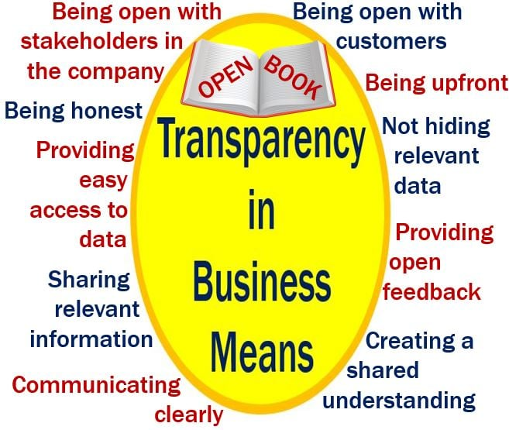
Notes:
Let me summarize this formula that can get companies and industry on their front foot:
Openness. How many companies would sign up for this list? Not many. Essential.

Slide 31
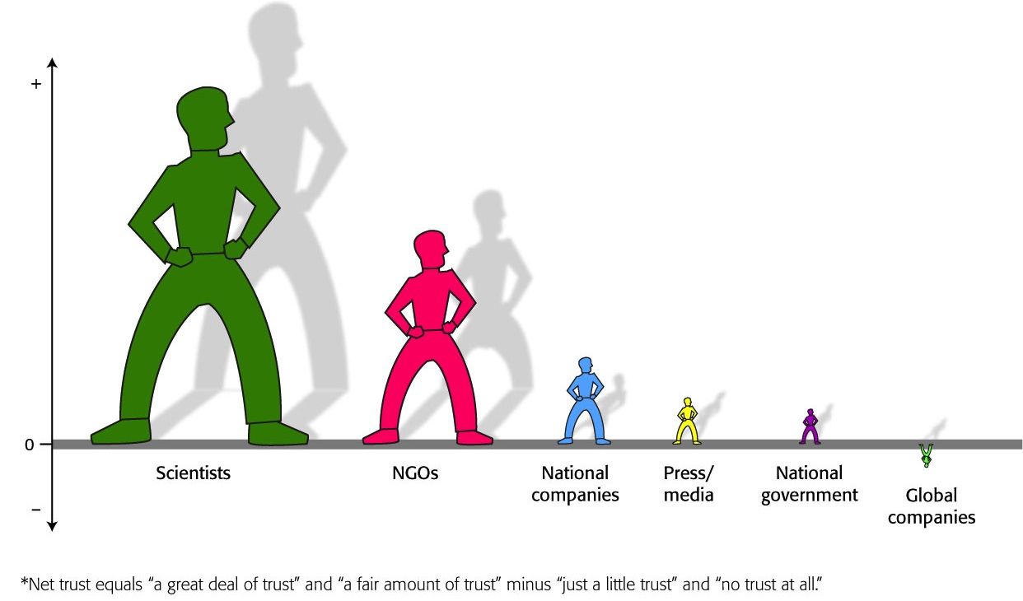

Trust gap between companies and scientists/NGOs
Net Trust in Institutions,* Average of 22 Countries
Notes:
Collaboration: Describe slide. NGO’s are fundamental to gain credibility. You have to look outside. You cannot go alone. Describe 1-10 scale.

Slide 32
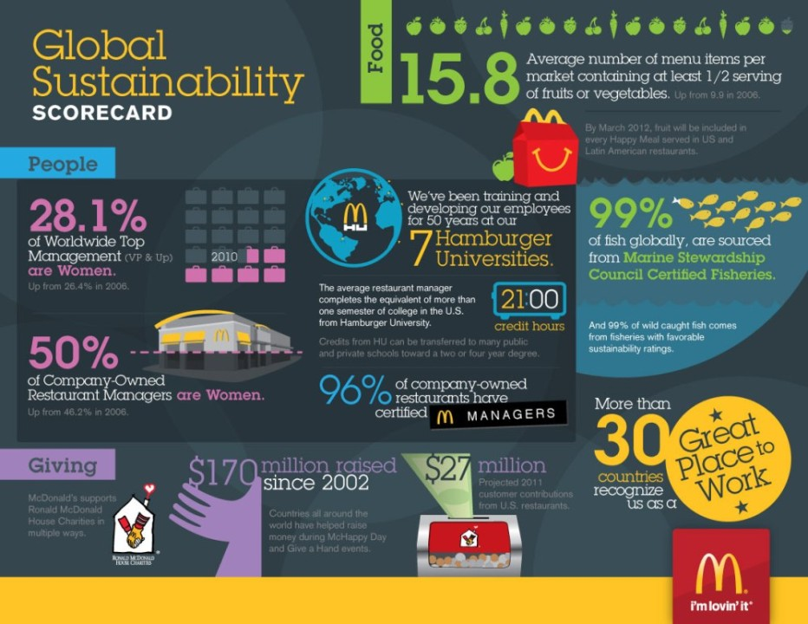
Notes:
3. Taking Action. Have to have proof points. Sustainable Beef: Industry said we are already sustainable. I said, maybe, but you can’t just say it. You have to measure it, report it, and prove it.

Slide 33
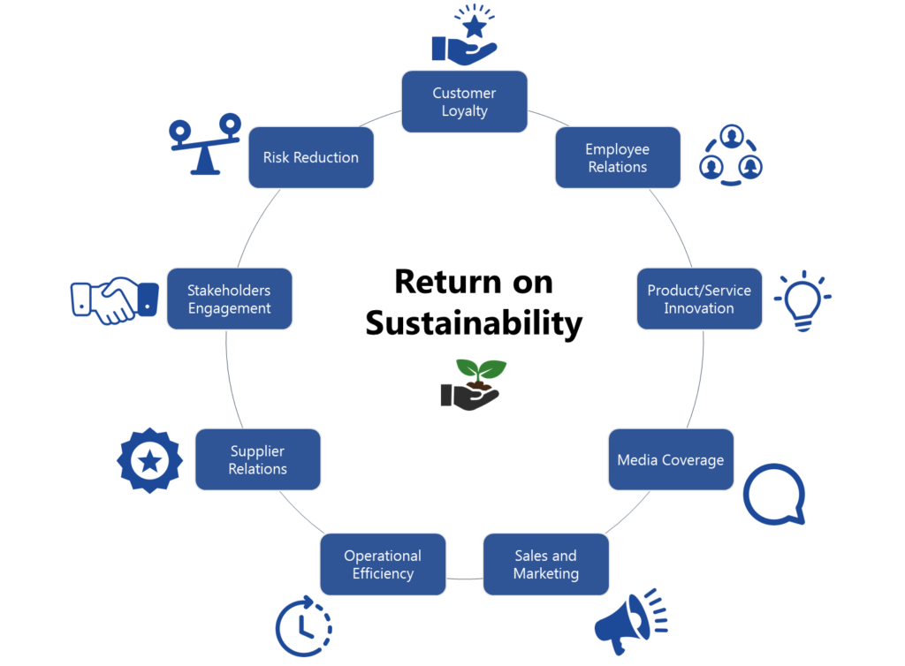
Notes:
Strategic. Create the business case you need which has a broad set of “returns”. Get started. Don’t worry about being perfect. Have thick skin. You’ll still be criticized. But now you are defining your future.

Slide 34
Improving our Brand Health by 1%
=
2% increase in sales
(Sustainability = 50% of Brand attributes)
Notes:
I wanted to highlight the biggest part of our business Case. Our brand. Describe this.
34

Slide 35
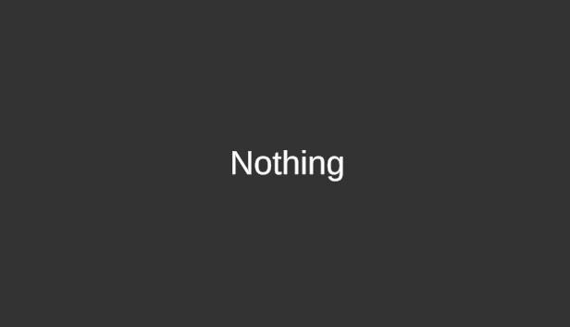
Notes:
So that’s our journey…..Starting as most companies back in the late 80’s.
No such thing as CSR, ESG, and Sustainability.

Slide 36


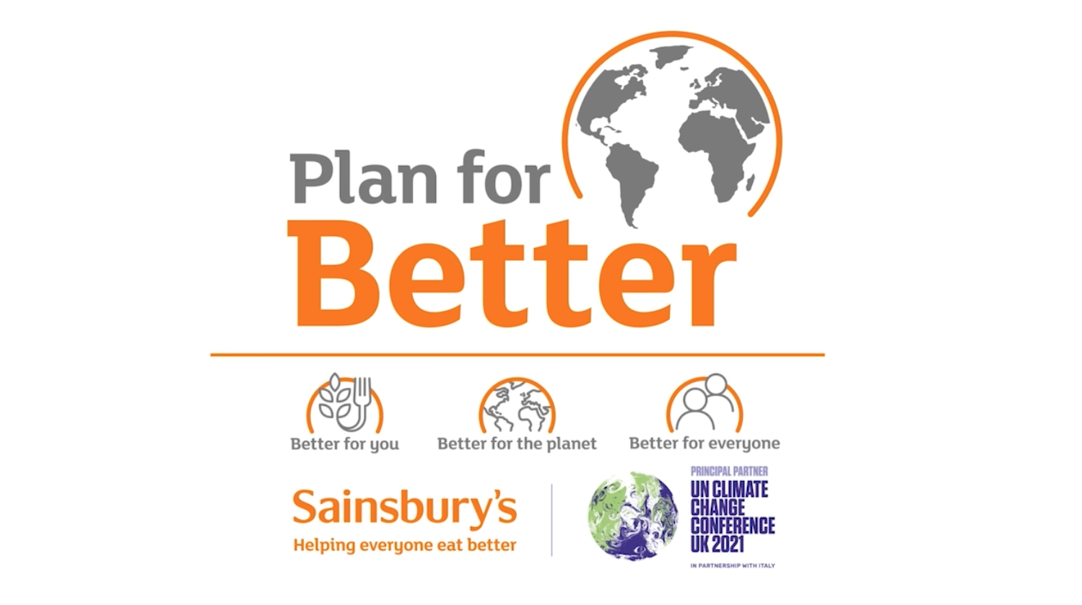
Notes:
Fast forward 30 years:
Schools, degrees, international standards
CSR reports
CSR staff, CSO

Slide 37

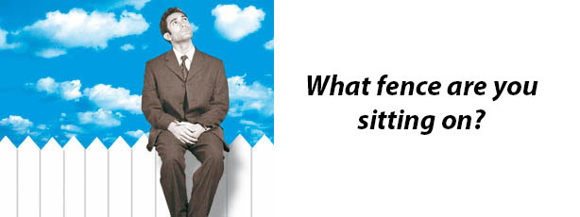
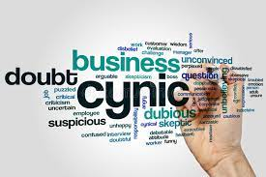
Believers
Fence Sitters
Skeptics
Notes:
So Believers: Go back and do more to rally your organization to be a leader, get more strategic.
Skeptics: There’s a role for you, too. Keep your organization grounded on reality. Make your plan practical. Don’t commit to things that are simple PR moves. Believe me, many companies do this.
Fence sitters: Where most of you probably are; Step up, Volunteer, Get Involved.
This

Slide 38
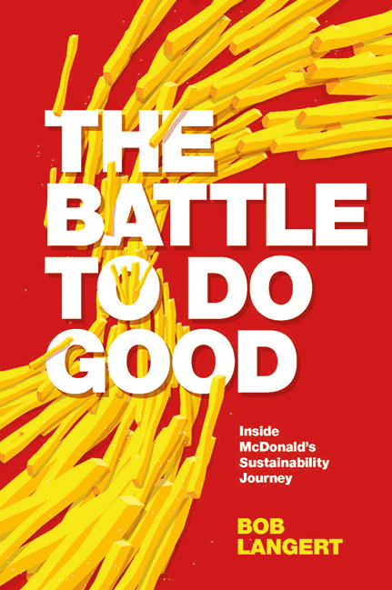
The Social License Challenge:
Open
Collaborative
Action-oriented
Strategic
THANK YOU!
langertbob@gmail.com
LinkedIn: @boblangert
Notes:
I hope I have laid out ideas to help you in your journey to serve society and your business.
You can do it!
You have a great, majestic sport and magnificent animals.
You can not only deal with the pressing issues of today and tomorrow, but I am so convinced you can turn into an opportunity to grow your business and grow your relevance to more consumers.

