Slide 1



SOCIAL LICENCE AND THE
RANDOX GRAND NATIONAL
NEVIN TRUESDALE
Chief Executive, Jockey Club

Slide 2


3 - 5 April 2025

Slide 3
Contents
JCR Welfare Commitment
Data Led Changes
Public Perception
2024 Randox Grand National
Evolution not Revolution
Media Announcement and Coverage
Notes:
The RGN has never stood still.
Inception in 1839,
Becoming a handicap in 1843,
Being moved from a Friday to a Saturday in 1947.
Right through to the near closure of the racecourse in 1975.
Why the race is loved – so many stories:
Devon Loch
Foinavon
Red Rum
Bob Champion & Aldaniti
Void National
Bomb Scare - 1997
Rachel Blackmore
A potted history of more recent changes is on the slide, but the race has evolved over time to the become the worldwide event that it is today.
In addition to the slide, can mention:
Upgraded Vet facilities 2008
Increase in no of vets on course in 2023 +2 so now total of 13 + BHA Vos
Mounted Catchers x4 increased to x6 in 2023
Entry requirements tightened over the years – most recently 6 Chase run requirement.
Also – must have finished 1st-4th in chase 2m7.5f+ in career, must run in chase during current season
Rider requirements – not less than 15 winners, at least 10 over chase fences
Reserves removed in 2023

Slide 4
The Jockey Club – Welfare Commitment
A relentless focus on welfare, in conjunction with the BHA, to ensure that we minimise avoidable risk for horses, whether that is through enhanced pre-race veterinary checks making changes to fences and the conditions of our races
Since 2018, £2.5m of ring-fenced investment has been used to improve and enhance our facilities, in pursuit of delivering elevated standards for our equine athletes. This is in addition to the significant investment made every year to provide the safest possible racing surface
Equine welfare is a key strategic pillar of the Jockey Club’s strategy ‘Ensure equine and people welfare is at the centre of everything we do’
The Jockey Club has sponsored of the RoR Championship at Aintree’s Equestrian Centre for the past three years. Aintree’s Head of Racing, Sulekha Varma is a key member of the Industry's Horse Welfare Board
We continue to invest in our facilities to make sure that we offer our equine participants the best possible experience. From our investments in safe racing surfaces and cushioned horsewalks to state-of-the-art misting fans and washdown areas, every aspect of care is considered
The Jockey Club’s support and funding of the BHA’s successful, HorsePWR campaign
Notes:
The RGN has never stood still.
Inception in 1839,
Becoming a handicap in 1843,
Being moved from a Friday to a Saturday in 1947.
Right through to the near closure of the racecourse in 1975.
Why the race is loved – so many stories:
Devon Loch
Foinavon
Red Rum
Bob Champion & Aldaniti
Void National
Bomb Scare - 1997
Rachel Blackmore
A potted history of more recent changes is on the slide, but the race has evolved over time to the become the worldwide event that it is today.
In addition to the slide, can mention:
Upgraded Vet facilities 2008
Increase in no of vets on course in 2023 +2 so now total of 13 + BHA Vos
Mounted Catchers x4 increased to x6 in 2023
Entry requirements tightened over the years – most recently 6 Chase run requirement.
Also – must have finished 1st-4th in chase 2m7.5f+ in career, must run in chase during current season
Rider requirements – not less than 15 winners, at least 10 over chase fences
Reserves removed in 2023

Slide 5
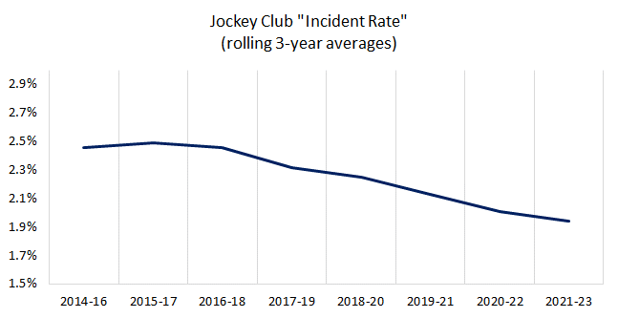
Incident Rates – Jockey Club
Notes:
The RGN has never stood still.
Inception in 1839,
Becoming a handicap in 1843,
Being moved from a Friday to a Saturday in 1947.
Right through to the near closure of the racecourse in 1975.
Why the race is loved – so many stories:
Devon Loch
Foinavon
Red Rum
Bob Champion & Aldaniti
Void National
Bomb Scare - 1997
Rachel Blackmore
A potted history of more recent changes is on the slide, but the race has evolved over time to the become the worldwide event that it is today.
In addition to the slide, can mention:
Upgraded Vet facilities 2008
Increase in no of vets on course in 2023 +2 so now total of 13 + BHA Vos
Mounted Catchers x4 increased to x6 in 2023
Entry requirements tightened over the years – most recently 6 Chase run requirement.
Also – must have finished 1st-4th in chase 2m7.5f+ in career, must run in chase during current season
Rider requirements – not less than 15 winners, at least 10 over chase fences
Reserves removed in 2023

Slide 6
Public Perception

Slide 7
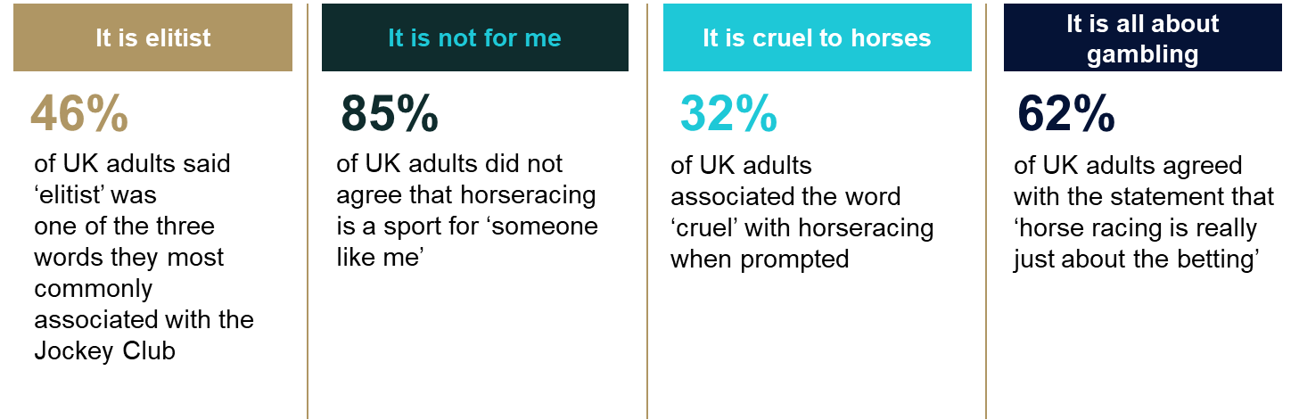
Racing is facing significant challenges when it comes to public perception
Source - Teneo & Find Out Now: a nationally representative consumer poll of 1,303 people, run on 19th April 2023

Slide 8
More than half concerned about welfare, but a significant group not concerned, or haven’t made up their minds
42% of people sit at the extreme ends of the spectrum, and say they are either very concerned (27%) or not concerned at all (14%) about horse welfare in racing.
That means there is a significant cohort of people who could be classed as ‘persuadable’ on the issue of horse welfare – 56% of people are quite concerned, not very concerned, or haven’t made up their mind yet, and will be most open to being convinced one way or the other.
Persuadable
Source - Teneo & Find Out Now: a nationally representative consumer poll of 1,303 people, run on 19th April 2023

Slide 9
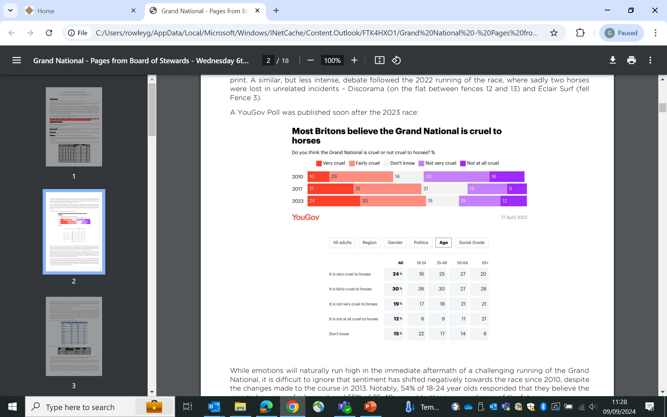
Is the Grand National cruel to horses – You Gov Poll
Source: YouGov Poll published on 17th April after the 2023 Grand National

Slide 10
Evolution not Revolution

Slide 11
Evolution
1999
2011
£150k invested in pop-up irrigation, with a further £100k spent in 2013
2013
Grand National Review Panel formed
Timber cores on all fences replaced with Easyfix tubs and plastic birch which the spruce is then laced into. Additional catching pens installed at Fences 4 & 12
2009
Bypass areas and Canal Turn catching pen constructed
2011
Introduction of formal pre-racing briefings between Officials and Jockeys
2015
Course formally surveyed - official distance reduced to 4m2f 74yds
2011
2011
Compulsory guided Course Walks with Jockey Coaches for all jockeys who have ridden over GN Fences at GN Meeting less than three times
2023
Introduction of one-to-one Jockeys Briefings conducted by senior ex-jockeys/Jockey Coaches
Bechers Brook landing levelled (further work in 2013)
2011-2013
2012
2023
Enhanced Veterinary checks introduced with compulsory trot up videos and veterinary records to be provided from 8 weeks pre-race
3yr R&D into cores of fences – all non-ditch fences cores replaced, April 2013
Landing areas of fences 4, 5 & 13 levelled.
Notes:
The RGN has never stood still.
Inception in 1839,
Becoming a handicap in 1843,
Being moved from a Friday to a Saturday in 1947.
Right through to the near closure of the racecourse in 1975.
Why the race is loved – so many stories:
Devon Loch
Foinavon
Red Rum
Bob Champion & Aldaniti
Void National
Bomb Scare - 1997
Rachel Blackmore
A potted history of more recent changes is on the slide, but the race has evolved over time to the become the worldwide event that it is today.
In addition to the slide, can mention:
Upgraded Vet facilities 2008
Increase in no of vets on course in 2023 +2 so now total of 13 + BHA Vos
Mounted Catchers x4 increased to x6 in 2023
Entry requirements tightened over the years – most recently 6 Chase run requirement.
Also – must have finished 1st-4th in chase 2m7.5f+ in career, must run in chase during current season
Rider requirements – not less than 15 winners, at least 10 over chase fences
Reserves removed in 2023

Slide 12
Data Led Changes

Slide 13
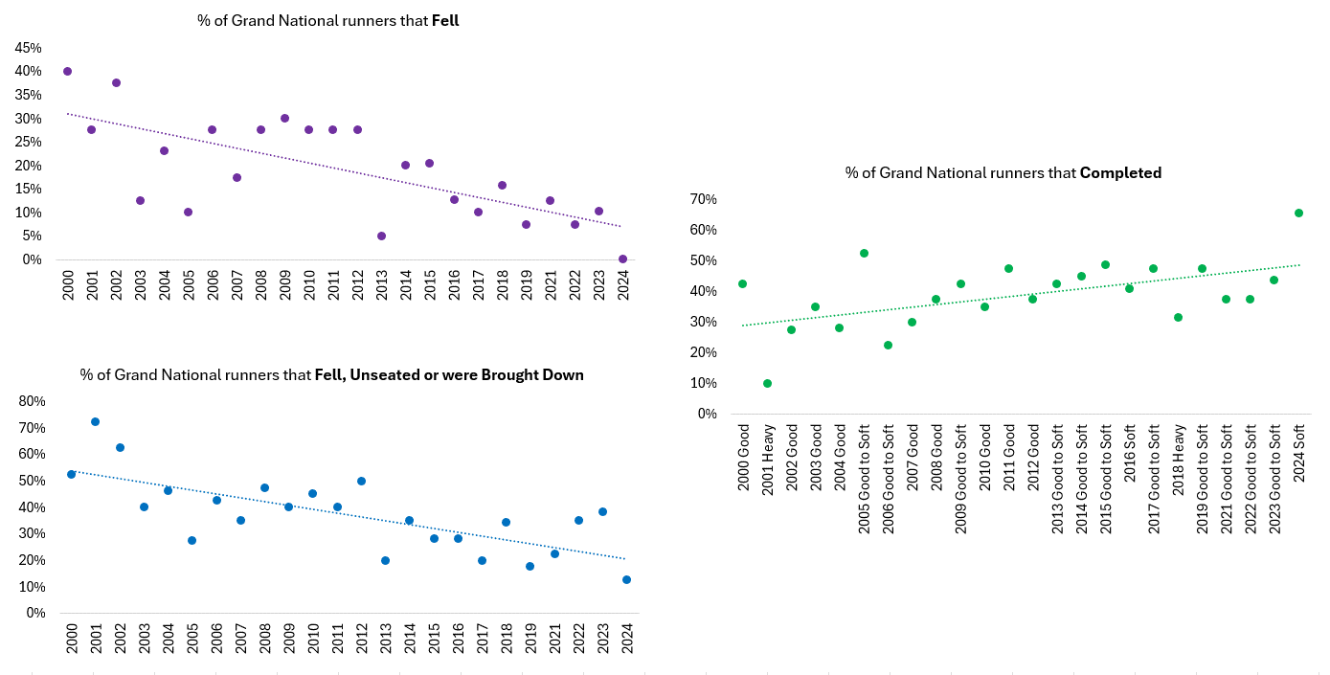
Grand National Statistics 2000-2024
Notes:
The RGN has never stood still.
Inception in 1839,
Becoming a handicap in 1843,
Being moved from a Friday to a Saturday in 1947.
Right through to the near closure of the racecourse in 1975.
Why the race is loved – so many stories:
Devon Loch
Foinavon
Red Rum
Bob Champion & Aldaniti
Void National
Bomb Scare - 1997
Rachel Blackmore
A potted history of more recent changes is on the slide, but the race has evolved over time to the become the worldwide event that it is today.
In addition to the slide, can mention:
Upgraded Vet facilities 2008
Increase in no of vets on course in 2023 +2 so now total of 13 + BHA Vos
Mounted Catchers x4 increased to x6 in 2023
Entry requirements tightened over the years – most recently 6 Chase run requirement.
Also – must have finished 1st-4th in chase 2m7.5f+ in career, must run in chase during current season
Rider requirements – not less than 15 winners, at least 10 over chase fences
Reserves removed in 2023

Slide 14
Data led to inform changes
INTERNAL ANALYSIS
Led by Aintree’s Clerk of the Course, Sulekha Varma and Head Veterinary Advisor, Chris Proudman
JUMP RACE RISK MODEL
A powerful data and epidemiology hub to identify risk factors in jump racing
ACADEMIC PAPERS & REPORTS
Multiple published scientific literature based on risks of horses falling, including ‘GN Study Nature’, ‘Preventative Vet Medicine’ and the ‘Veterinary Record’
SIMON ROWLANDS
Data analysis from Simon Rowlands’ Racing and Research, who works with ITV Racing/Ruby Walsh – key data on form, time and sectional analyst to help shape decisions
Notes:
With this evolution has come change.
Horses travelling faster in the race (proven by stats)
Better quality horses running for richest jump race in Europe (proven by stats)
Safer obstacles = course ridden with more confidence as years have passed. Video on next slide shows 2008, 2012, 2013, 2022 & 2023 fences 1-6. Notable increase in horses taking inside line and bunching on inside. (NB 2022 shows and mentions Éclair Surf fall). None on wide outside.

Slide 15
Change
SPEED
Average time between 1st and Becher’s Brook:
  1965 and 2012 = 67.7s
  2013 to 2022 = 66.8s.
A difference of 0.9s, or just over 4 lengths.
QUALITY
Since 2013, top-rated horse has increased from 158 to 167 and the mean rating from 144.7 to 150.6
OBSTACLES
Safer obstacles ridden with greater confidence
More riders taking inside line and travelling faster
VETERINARY
Pre-race Veterinary checks enhanced in 2016 and again in 2023. Videos and Veterinary Medical Records now submitted in advance
Notes:
With this evolution has come change.
Horses travelling faster in the race (proven by stats)
Better quality horses running for richest jump race in Europe (proven by stats)
Safer obstacles = course ridden with more confidence as years have passed. Video on next slide shows 2008, 2012, 2013, 2022 & 2023 fences 1-6. Notable increase in horses taking inside line and bunching on inside. (NB 2022 shows and mentions Éclair Surf fall). None on wide outside.

Slide 16
2024 Randox Grand National
First fence moved 60yds closer to the start
Landing side of Fence 11 levelled
Extension of pop-up irrigation system
Rubber pads on front of toe-boards
Movement of rail to assist with loose horse management
THE COURSE
All races over Grand National Fences to have standing starts
Mown strip under start line
Safety Factor reduced from 40 to 34 runners
Parade no longer led
Widen Parade Ring Walkways
THE START
OFF TIME
Earlier start time at 4pm rather than 5.15pm for the race to:
  Reduce time for ground to dry out
  Reduce build-up of pressure through the day
SUITABILITY TO RACE
Extend early intervention veterinary checks to Foxhunter and Topham
(introduced for Grand National in 2023)
Increase minimum rating for entry to 130
Add ‘mistake %’ as a flag for Grand National Review Panel assessment of suitability

Slide 17


Slide 18
Media Announcement and Coverage

Slide 19
Media Announcement – October 2023
Realistic that the world is ever-changing and there will always be criticism for making changes, but aiming to strike the right balance, both within and outside of our sport
Detailed Press Release with several quotes from key industry figures including Ruby Walsh, Julie Harrington, Lucinda Russell etc
Key Industry Figures Consultation including Trainers, Jockeys, BHA, NTF, PJA, BHA Board & Exec, RSPCA, WHW, HWB
Press Conference
  Embargoed press release and press conference 24 hours prior to announcement to ensure more considered coverage
  Embargoed broadcast interviews
Internal cascade to JC Stewards, Members and Employees
JCR video content released talking through the changes
  Key spokespeople – Sulekha Varma, Ruby Walsh and Chris Proudman
Notes:
The RGN has never stood still.
Inception in 1839,
Becoming a handicap in 1843,
Being moved from a Friday to a Saturday in 1947.
Right through to the near closure of the racecourse in 1975.
Why the race is loved – so many stories:
Devon Loch
Foinavon
Red Rum
Bob Champion & Aldaniti
Void National
Bomb Scare - 1997
Rachel Blackmore
A potted history of more recent changes is on the slide, but the race has evolved over time to the become the worldwide event that it is today.
In addition to the slide, can mention:
Upgraded Vet facilities 2008
Increase in no of vets on course in 2023 +2 so now total of 13 + BHA Vos
Mounted Catchers x4 increased to x6 in 2023
Entry requirements tightened over the years – most recently 6 Chase run requirement.
Also – must have finished 1st-4th in chase 2m7.5f+ in career, must run in chase during current season
Rider requirements – not less than 15 winners, at least 10 over chase fences
Reserves removed in 2023

Slide 20

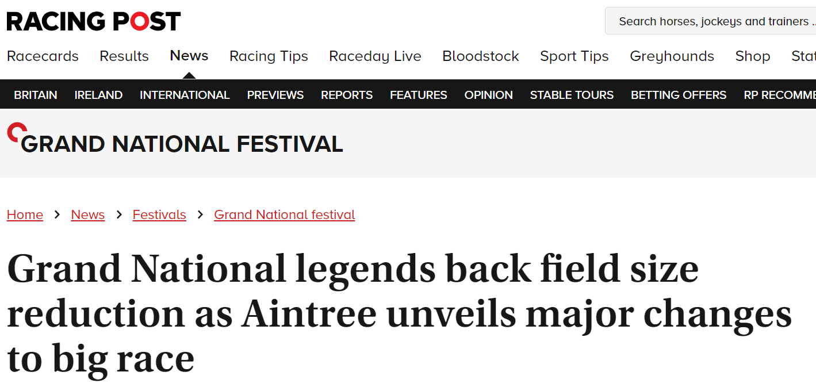
Media Coverage – Announcement
Notes:
Catering to different audiences – racing and non-racing.
Positioning The Jockey Club as putting Equine Welfare first.
Recognising that not all coverage would be positive.
Media briefing day before formal announcmenet – attended by c30-35 journalists, print & broadcast, racing & non-racing (although racing predominant)
Opportunity to answer questions, present facts etc, prior to formal publication of changes.
Balance of reporting tipped in favour of factual and positive, rather than negative.
Long but detailed press release+ Executive summary of changes + foreword from respected Vet, Professor Chris Proudman

Slide 21
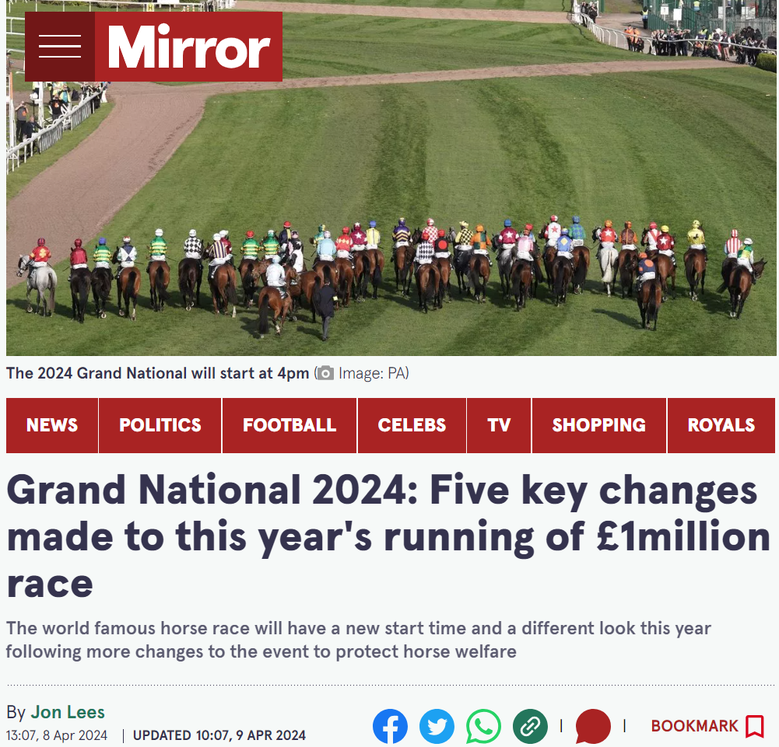



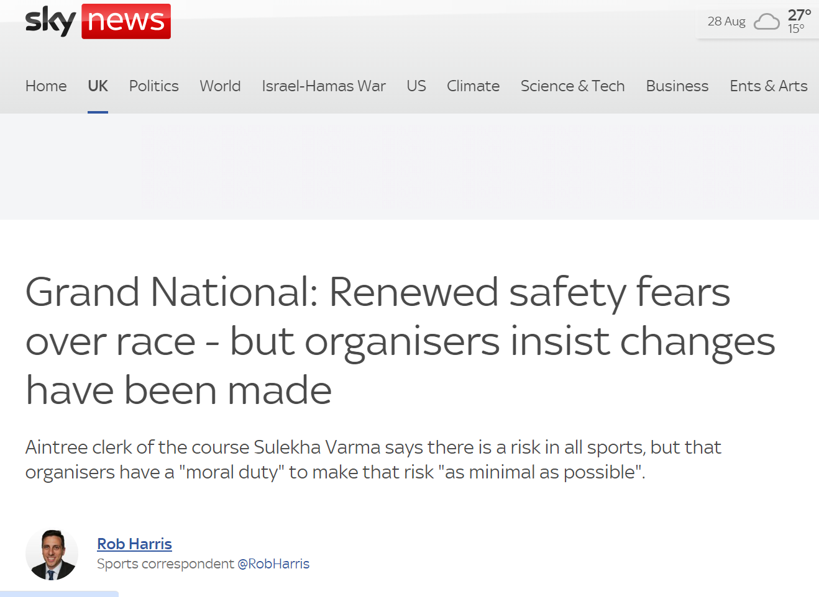
Media Coverage – Pre-National
Notes:
Catering to different audiences – racing and non-racing.
Positioning The Jockey Club as putting Equine Welfare first.
Recognising that not all coverage would be positive.
Media briefing day before formal announcmenet – attended by c30-35 journalists, print & broadcast, racing & non-racing (although racing predominant)
Opportunity to answer questions, present facts etc, prior to formal publication of changes.
Balance of reporting tipped in favour of factual and positive, rather than negative.
Long but detailed press release+ Executive summary of changes + foreword from respected Vet, Professor Chris Proudman

Slide 22
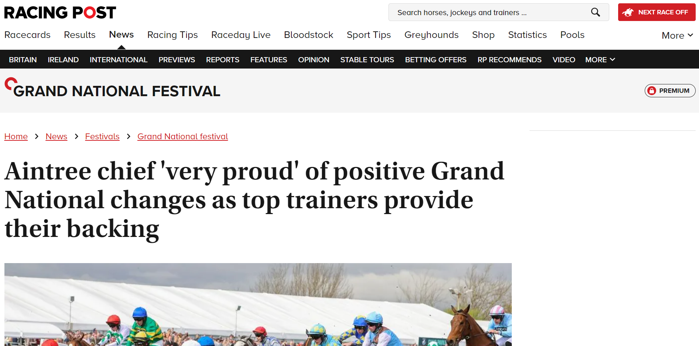

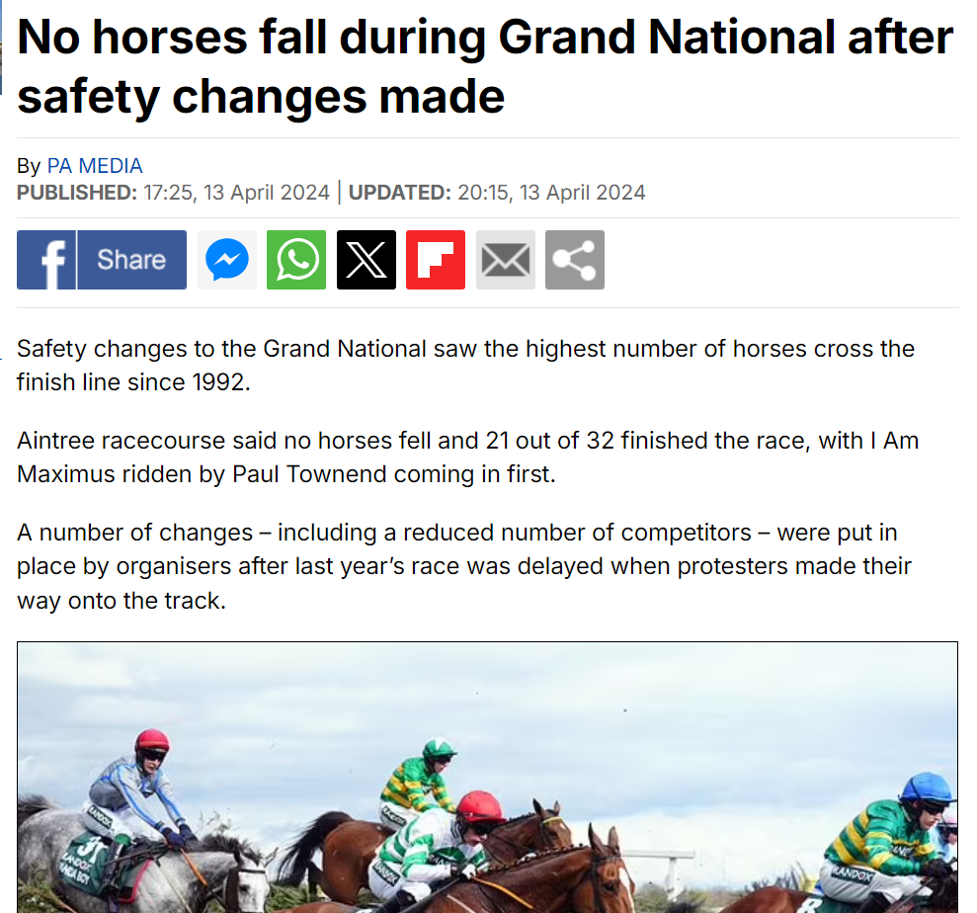
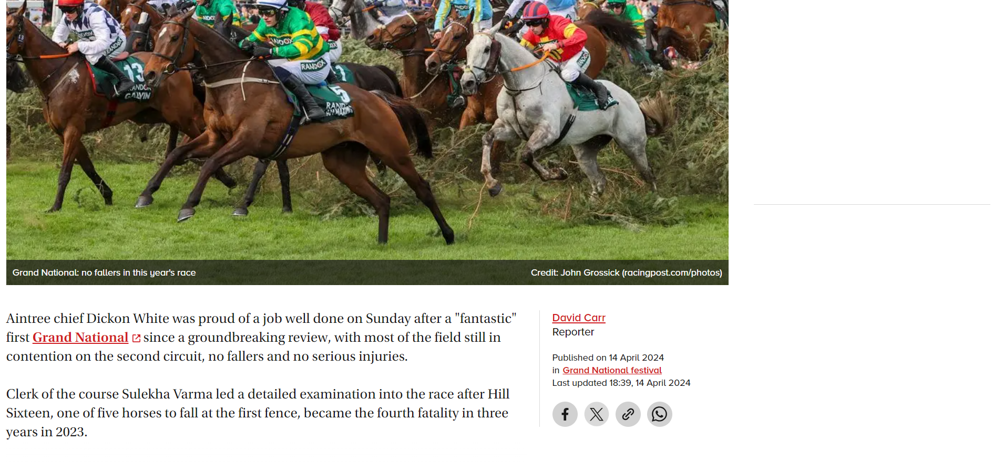
Media Coverage – Post-National
Notes:
Important to have respected industry voices working in support.
Conversations with leading trainers, NTF, PJA, RSPCA, WHW,

Slide 23
Grand National Media Report
12,100 pieces of coverage reported on the Jockey Club in the UK from 11th Feb – 22nd April 2024
More than half (61%) of items reporting on the Jockey Club came within the Grand National 11th-13th April
Positive and Neutral sentiment emerged within coverage throughout the reporting period
February saw coverage on security at The Grand National and discussions on the expected participants
Throughout the course of April, Grand National mentions saw visibility in general news around the event and expected participants. Fashion trends, animal activists’ groups and safety measures at The Grand National emerged as key topics driving mentions
‘Create safe and enjoyable experiences for everyone’ emerged as the most prolific theme within reporting
Negative volumes were also highest within this topic, with coverage relating to the ongoing drugs/alcohol issues at the Grand National. Alongside this measures to improve safety and enjoyment we are also prominent, most notably the new race start time.
Looking at the 3 race days, sentiment was overwhelmingly more favourable when compared to 2023
Changes made to improve spectator safety and enjoyment as well as improved welfare of the animals in response to last year’s event which was impacted by the Animal Rising protest group were well received.
Notes:
The RGN has never stood still.
Inception in 1839,
Becoming a handicap in 1843,
Being moved from a Friday to a Saturday in 1947.
Right through to the near closure of the racecourse in 1975.
Why the race is loved – so many stories:
Devon Loch
Foinavon
Red Rum
Bob Champion & Aldaniti
Void National
Bomb Scare - 1997
Rachel Blackmore
A potted history of more recent changes is on the slide, but the race has evolved over time to the become the worldwide event that it is today.
In addition to the slide, can mention:
Upgraded Vet facilities 2008
Increase in no of vets on course in 2023 +2 so now total of 13 + BHA Vos
Mounted Catchers x4 increased to x6 in 2023
Entry requirements tightened over the years – most recently 6 Chase run requirement.
Also – must have finished 1st-4th in chase 2m7.5f+ in career, must run in chase during current season
Rider requirements – not less than 15 winners, at least 10 over chase fences
Reserves removed in 2023

Slide 24


Slide 25


