Slide 1

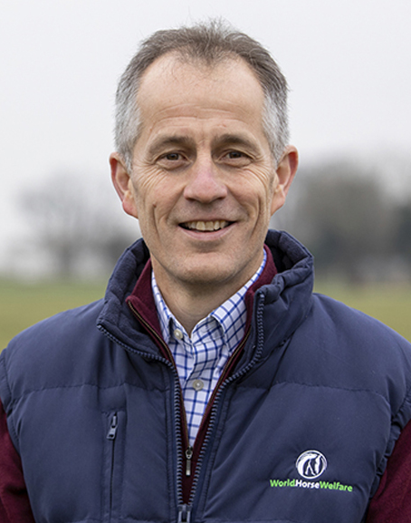

PUBLIC PERCEPTION OF HORSES IN SPORT
ROLY
OWERS
Chief Executive,
World Horse Welfare

Slide 2
Public perception of horses in sport
Roly Owers MRCVS
World Horse Welfare

Slide 3


Perceptions of UK public and ‘horse people’ re the use of horses in sport
Representative sample of public
People who regularly interact with horses
I do not support the continued involvement of horses in sport in any circumstances
I support the continued involvement of horses in sport only if their welfare improves
There should be more safety and welfare measures in place in horse sports
14%
43%
52%
YouGov research conducted in UK 29–30 May, 2024; N=4,195
Notes:
Let’s get straight into it: What data do we have that relate to the public perception of horses in sport?
May 2024: WHW commissioned YouGov (independent public opinion & data analysis company) to conduct a survey of a representative sample of the British public (N=4195)
20% did not support continued involvement of horses in sport in any circumstances, & 41% only supported this if welfare improves
The 20% & the 41% are additive – so that’s more than 60% who don’t like the status quo
And almost 60% think there should be more safety & welfare measures in place
CLICK
It’s not only the public – similar views from people who interact regularly with horses
With exception that 20% of total cohort did not support continued involvement of horses in sport in any circumstances, whereas only 14% of ‘regular horse interactors’ felt this way
Results very similar to those from May 2022 & 2023 – the dial hasn’t shifted over this timeframe of 2 years

Slide 4
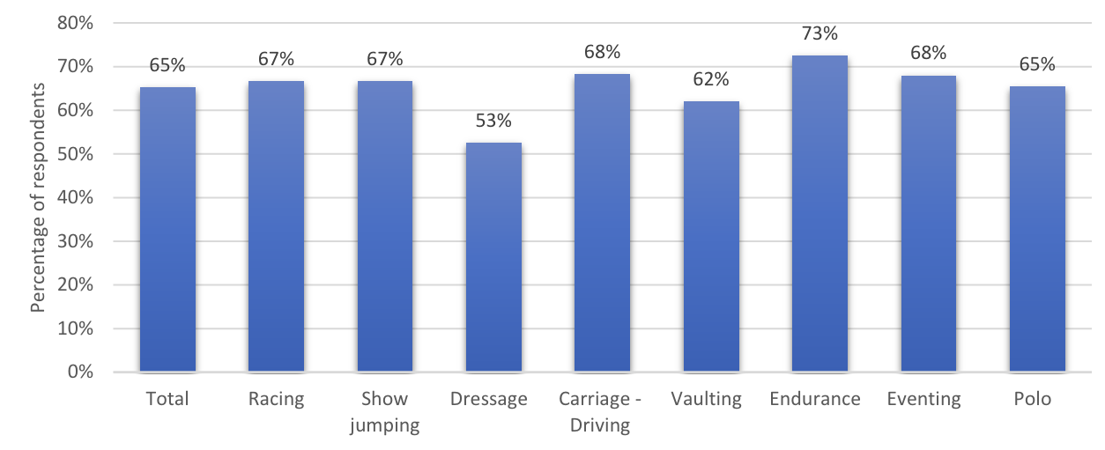
What do people think about racing?
14,000 respondents from 14 countries
Percentage of respondents with concerns about equine welfare in various equestrian sports
Mean
Data weighted to be representative of each country by age, region and genderSource: Equine Ethics and Wellbeing Commission for the FEI. Public Attitudes on the Use of Horses in Sport: Survey Report (November 2022)
Notes:
Survey results from UK are echoed by those from 2 surveys (again carried out by an independent company) at the behest of the FEI’s Equine Ethics and Wellbeing Commission
Public survey: 14,000 respondents from 14 countries: 52% think that welfare standards for horses in sport need improving
CLICK
Survey of equestrian stakeholders: 78% of almost 28,000 respondents from 116 countries agree
So it is not only the public who think that equestrianism has a welfare problem

Slide 5
So what?
Notes:
So what, you might say?
Maybe the public just don’t know what they are talking about - we don’t think that our sector has a serious equine welfare problem.

Slide 6
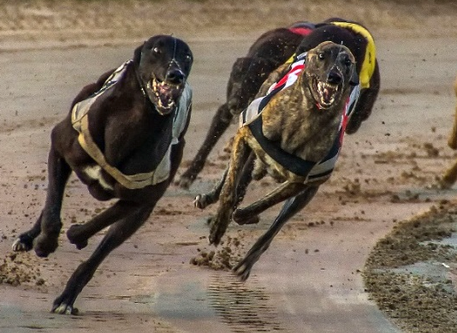
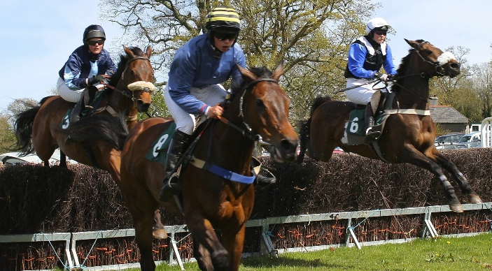
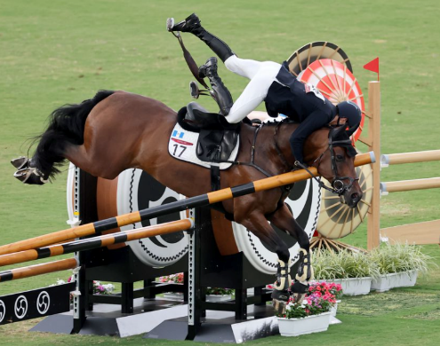
This is what…
Greyhound racing: Banned in parts of Australia and the USA and under threat in the UK
Jump racing:
Disappeared from most of Australia
Equestrianism:
Now lost from modern pentathlon
Notes:
Well - this is what
Greyhound racing has been banned in some parts of Australia and the US, and is under threat in the UK; Jump racing has disappeared in most of Australia; Equestrianism has now been lost from modern pentathlon at the Olympics, and racing is under pressure in UK
Animal welfare concerns underpinned the loss of all of these sports
Shows that the threat is real – and it is imminent
Because it isn’t about what WE think – it’s about what THE PUBLIC thinks – they hold the power here
But, as we cover in many of our presentations, there is lots that we can do to influence what the public thinks
Key point is that everyone involved in equestrianism – organisations AND individuals – plays a role in influencing public perception
Our collective actions determine whether or not things will reach a dangerous tipping point

Slide 7

Trust is central to public acceptance
Confidence
Transparency
TRUST
Shared values
First step: Establish what the public thinks
Credibility
Competence
Legitimacy
Notes:
So where are the goalposts in terms of influencing public acceptance of equestrianism, including racing?
Aim is to maintain – or improve – public acceptance; & we know that acceptance is heavily based on trust
Image shows attributes that feed into trust
Note ‘shared values’ – vitally important in terms of maintaining public trust
Can’t share the public’s values if don’t know what they are – so need to start by researching public sentiment

Slide 8
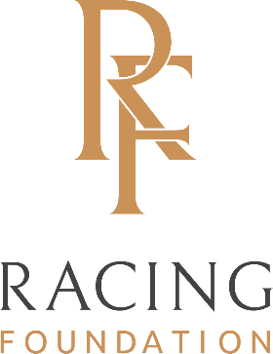

Engagement science project: UK, 2024
Research project facilitated by World Horse Welfare, with substantial funding from the Racing Foundation and contributions from the wider British equine sector
Aim: To determine drivers of public acceptance of a diverse range of horse sports, including racing
Methods
  Interviews with 12 horse sport stakeholders
  Nationally representative survey (UK, >5,000 people)
    Questions based on results of stakeholder interviews and work in other industries
    Quantitative and qualitative analysis
Voconiq. National survey of UK citizen attitudes towards UK equestrian sport industries. 2024
Notes:
World Horse Welfare: Instrumental in kick-starting project involving most major equestrian sports & groups in UK
Major funding from Racing Foundation, with contributions from multiple other UK stakeholders
Engaged an ‘engagement science’ company – ran large public survey in UK this year
Sophisticated analysis of the data that explains relationship between all of the measures in the survey, & how they influence acceptance
Methodology widely & successfully used in other sectors with public acceptance issues (e.g., mining)
Will present topline results only

Slide 9

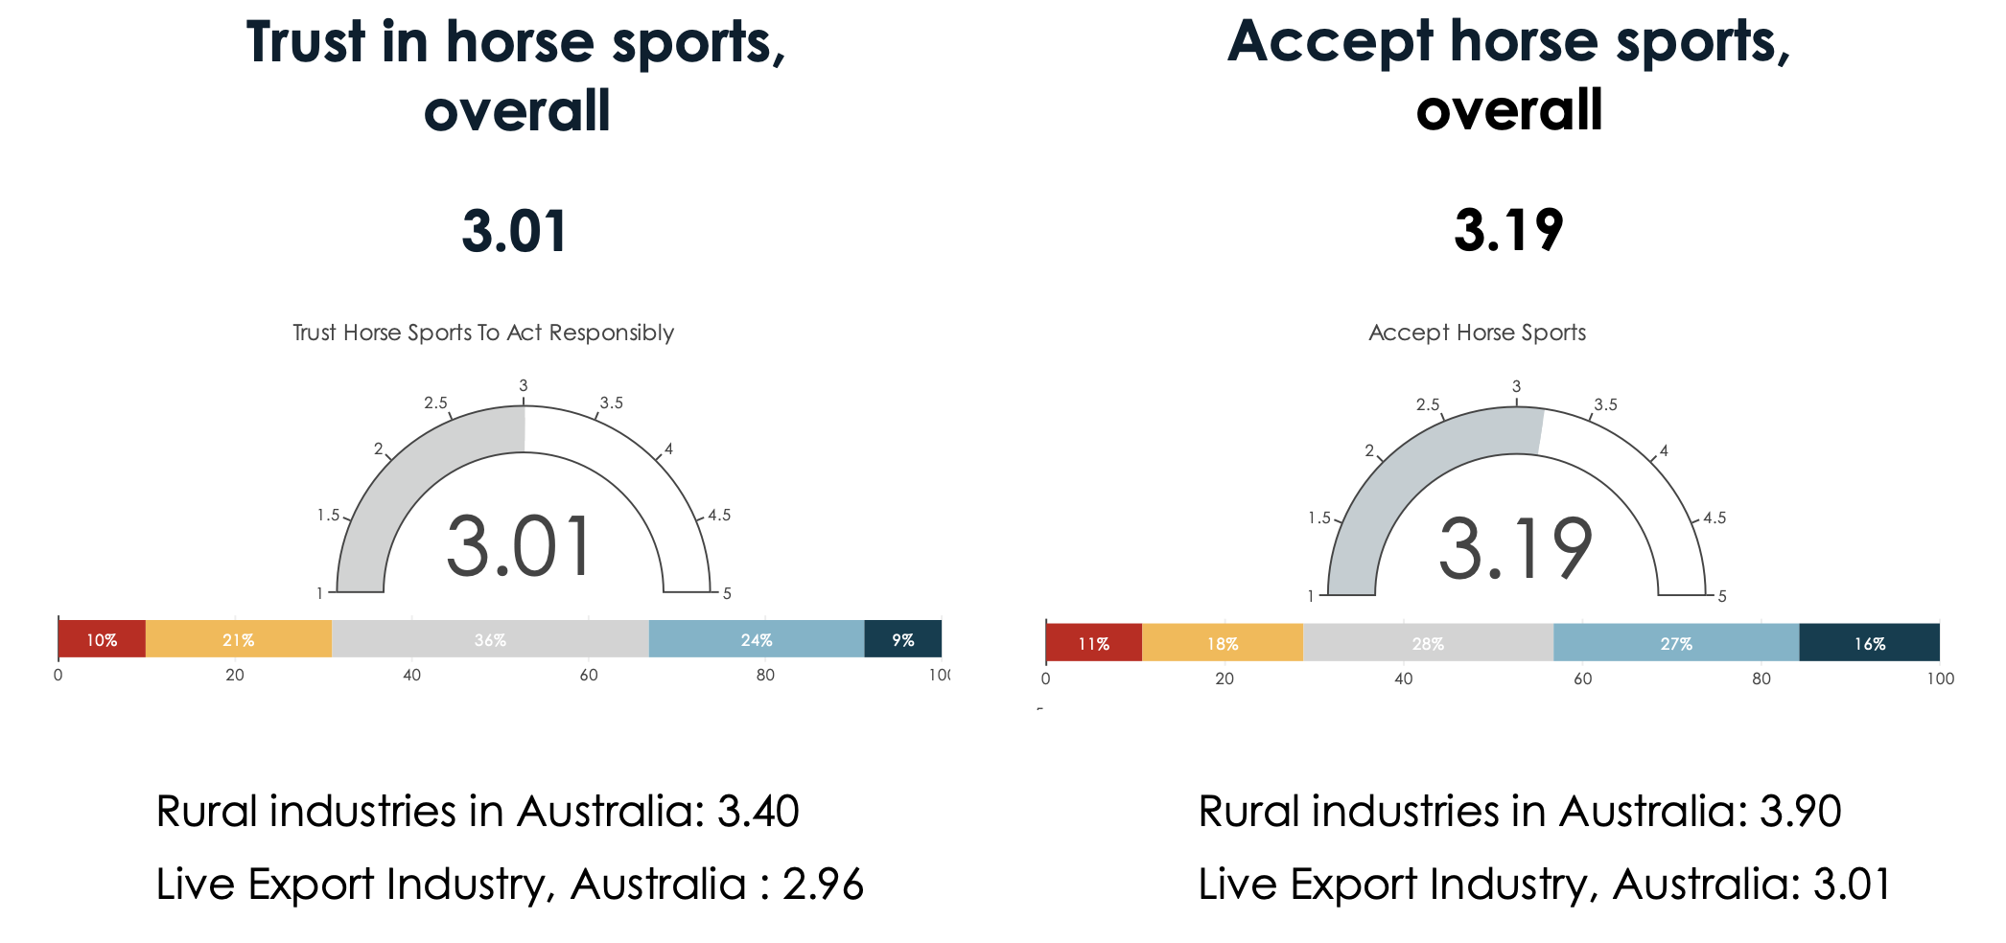
Trust & acceptance of horse sport in the UK
100
Voconiq. National survey of UK citizen attitudes towards UK equestrian sport industries. 2024
Notes:
Slide shows results for trust in, and acceptance of, horse sports overall in the UK
Scales run from 1 – 5
Trust sitting at 3.01 – very similar to live export in Australia…
“solid foundation of trust with community on which to build & strengthen the relationship; there is room, and a need, to improve this score over time to buffer sport from future potential headwinds”
Acceptance: “similar at 3.19”
“this level of acceptance is solid with strong opportunity for improvement over time”

Slide 10

What are the main drivers of acceptance of horse sport in the UK?
Acceptance
Trust
Acceptance
Voconiq. National survey of UK citizen attitudes towards UK equestrian sport industries. 2024
Notes:
Voconiq research has confirmed that trust is a major driver of acceptance
Big advantage of this work is that it has quantified this relationship; will now show the major drivers of both trust and acceptance of horse sport in the UK, and their relative importance
Results allow sport to focus its strategy on the factors that are of greatest importance to the public
And, if the research is repeated, to quantify progress

Slide 11

What are the main drivers of acceptance of horse sport in the UK?
Horse sports are socially important
0.23
Procedural fairness
Acceptance
0.21
0.49
Horse sports are transparent about injuries and fatalities
Trust
0.18
Acceptance
0.17
Procedural fairness:
Extent to which public feel as if horse sport listens to and respects their concerns
Related to the industry’s overall responsiveness and willingness to change its practices in response to those concerns
Distributional fairness:
Extent to which public feel that they receive fair share of the benefits that horse sport generates
Regulation
0.17
Distributional fairness
Notes:
Slide now shows drivers of trust
Each blue box shows the overall theme of multiple questions from the survey that all measured the same topic, but in slightly different ways
CLICK
Procedural & distributional fairness: See definitions on slide
Run through each driver very briefly
CLICK
Numbers show strength of each pathway relative to all others in model
Provides us with prioritised set of levers to pull to increase public trust and acceptance
Note that themes are often connected – e.g., transparency influences procedural fairness - so by acting in one area you should see progress in others

Slide 12
What are the main drivers of acceptance of horse sport in the UK?
Horse sports are socially important
0.12
0.23
Procedural fairness
Acceptance
0.21
0.49
Horse sports are transparent about injuries and fatalities
Trust
0.18
Acceptance
0.17
0.27
Regulation
-0.09
0.17
Distributional fairness
Horse breeding for sports is acceptable
Environmental impacts
Notes:
Finally, now we can see the themes that drive acceptance directly, not via trust – this is the full path model that resulted from the data
Advice is generally to concentrate on drivers of acceptance that work via trust

Slide 13
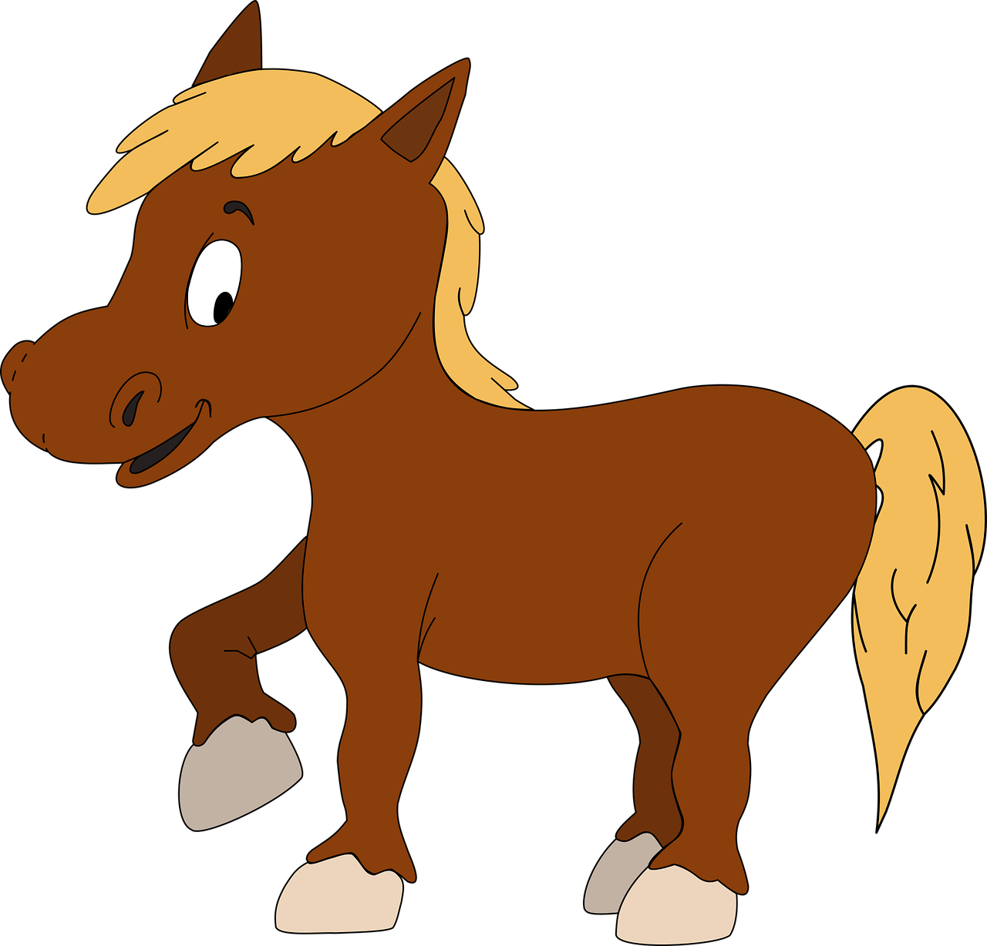
Equine welfare is threaded through most of the drivers of trust and acceptance
Horse sports are socially important
0.12
0.23
Procedural fairness
Acceptance
0.21
EQUINE WELFARE
0.49
Horse sports are transparent about injuries and fatalities
Trust
0.18
Acceptance
0.17
0.27
Regulation
-0.09
0.17
Distributional fairness
Horse breeding for sports is acceptable
Environmental impacts
Notes:
Statistical analysis did not pull out ‘equine welfare’ as a specific driver of trust or acceptance – but welfare is threaded through this model in multiple places
Survey respondents sent a very clear message regarding their expectations of the industry when it comes to welfare
This shone through in their responses to multiple qs (data not shown)
Is also self-evident that welfare underpins many of the drivers of trust & acceptance shown on the slide
Procedural fairness: This is about industry responsiveness to public concerns – many of which focus on welfare
Transparency about injuries & fatalities: Relationship to welfare obvious
Note that this item is just the welfare item that most energized respondents – should be interpreted as being representative of a ‘family’ of welfare concerns
Regulation: Public expects that regulations will cover welfare
Breeding: Breeding only likely to be acceptable if welfare is good

Slide 14
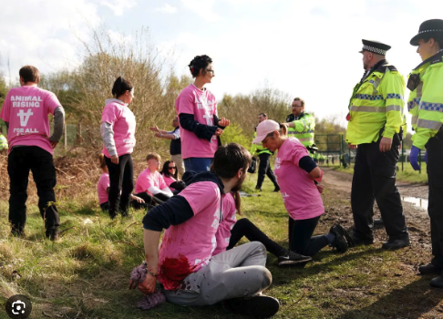

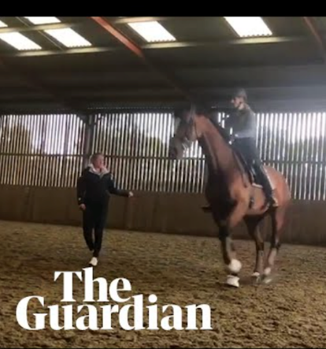
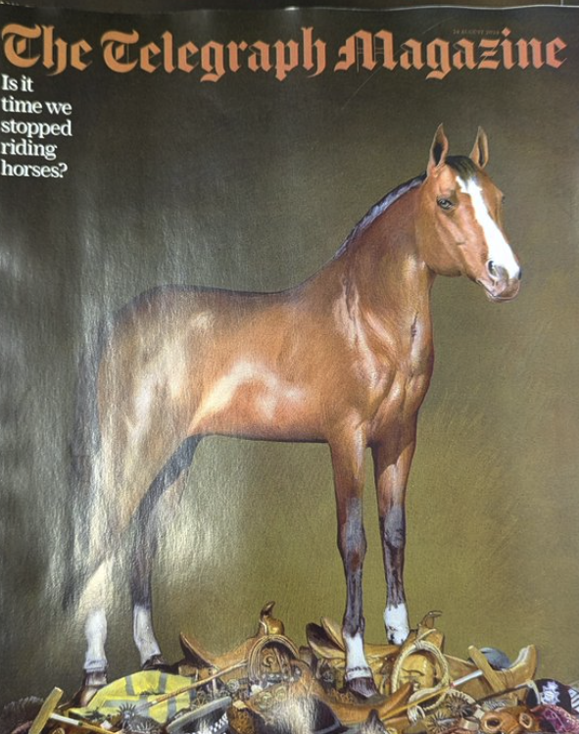
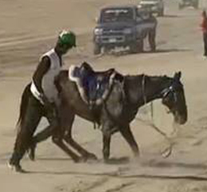

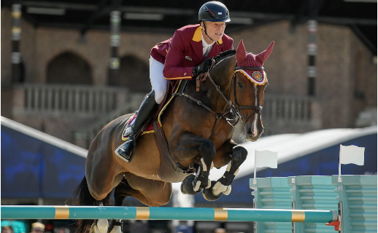

We need to build trust – now
‘How many horses died at the Grand National 2023?’
‘Charlotte Dujardin rides into storm after decorated Olympic career’
‘Why it might be time to stop riding horses’
‘Horror endurance pictures continue to shock’
‘New equestrian abuse scandal as Olympics rider accused of hitting horse with bar’
Notes:
Evident from the Voconiq work, and the results of previous surveys, that the entire equestrian industry needs to pull together and work to build public trust
Slide shows adverse headlines that have made it into the mainstream media recently in relation to a range of disciplines
Racing, endurance, show jumping, dressage
Most recently: Telegraph piece questioning whether people should be riding horses at all

Slide 15
We need to build trust – now
Trust in horse sports, overall
‘Why it might be time to stop riding horses’
Notes:
We need to move the dial

