Slide 1

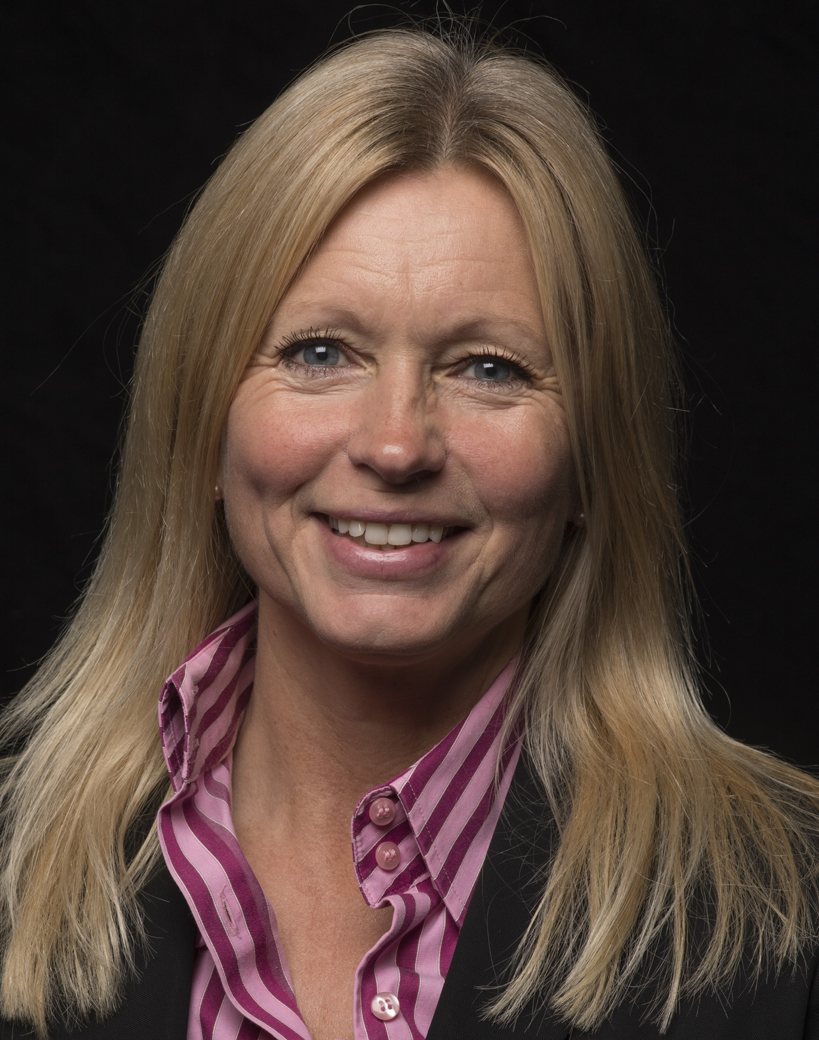

INTRODUCTION
TANSY
CHALLIS
Chief Executive, Racing Foundation

Slide 2
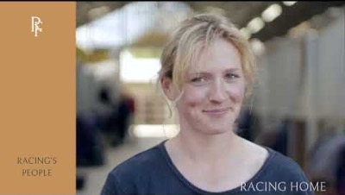

Slide 3
“Industries who operate with impunity, during the current era of scrutiny do so at their own risk. It is no longer acceptable to say, “but we’ve always done it this way.” It is no longer acceptable to say, “if we just educate the naysayers, they’ll understand our position.””
C.R. Heleski

Slide 4


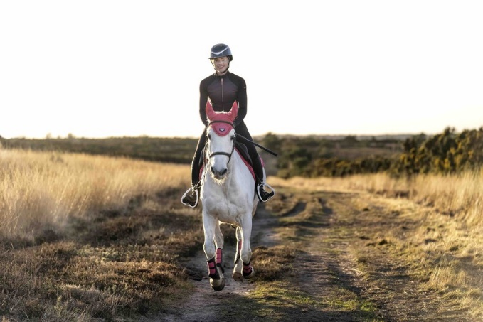

Slide 5
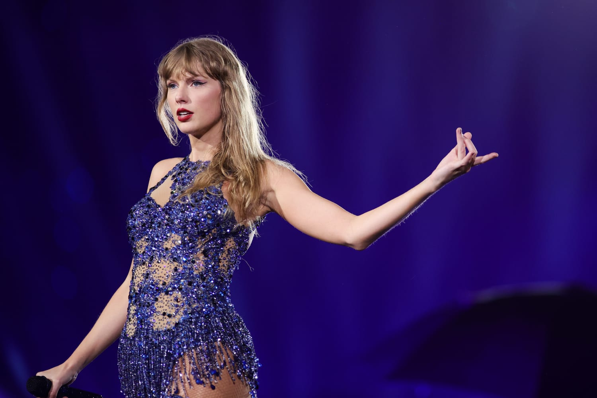

Taylor Swift has cancelled a gig at the Melbourne Cup in Australia after coming under fire from animal rights activists
284 million Instagram followers

Slide 6


